Slide 1

Chapter 3
Solving Nonlinear Equations

Slide 2
Core Topics
(i) Estimation of Errors in Numerical Solutions (3.2)
(ii) Bisection Method (3.3)
(iii) Regula Falsi Method (3.4)
(iv) Newton’s Method (3.5)
(v) Secant Method (3.6)
(vi) Fixed Point Iteration Method (3.7)
(vii) Use of MATLAB built in Functions for Solving Nonlinear Equations (3.8)
(viii) Equations with Multiple Roots (3.9)
(ix) Systems of Nonlinear Equations (3.10)

Slide 3
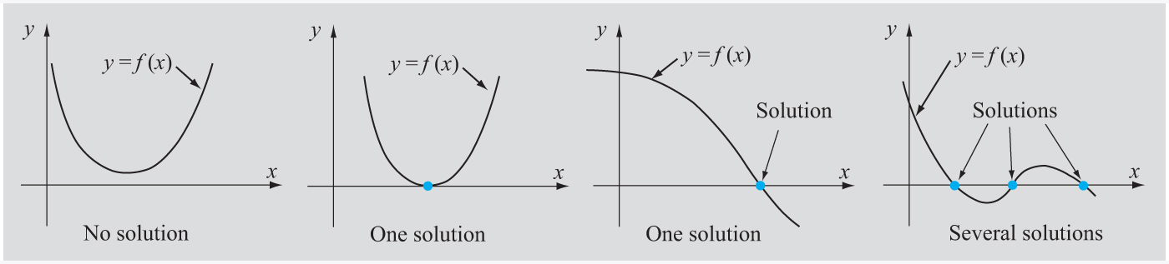
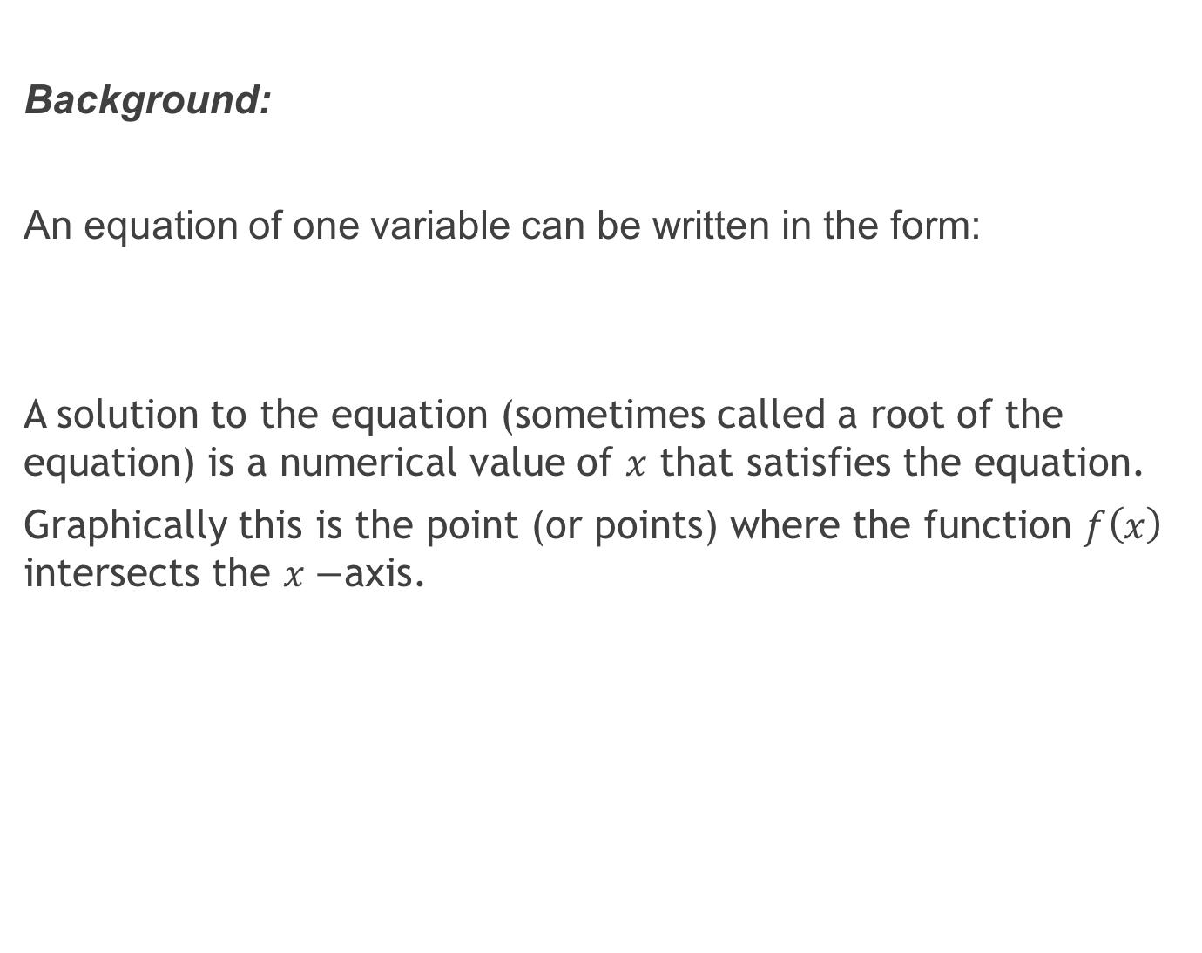
Background:
An equation of one variable can be written in the form:
A solution to the equation (sometimes called a root of the equation) is a numerical value of $x$ that satisfies the equation.
Graphically this is the point (or points) where the function $f\left(x\right)$ intersects the $x−$axis.

Slide 4
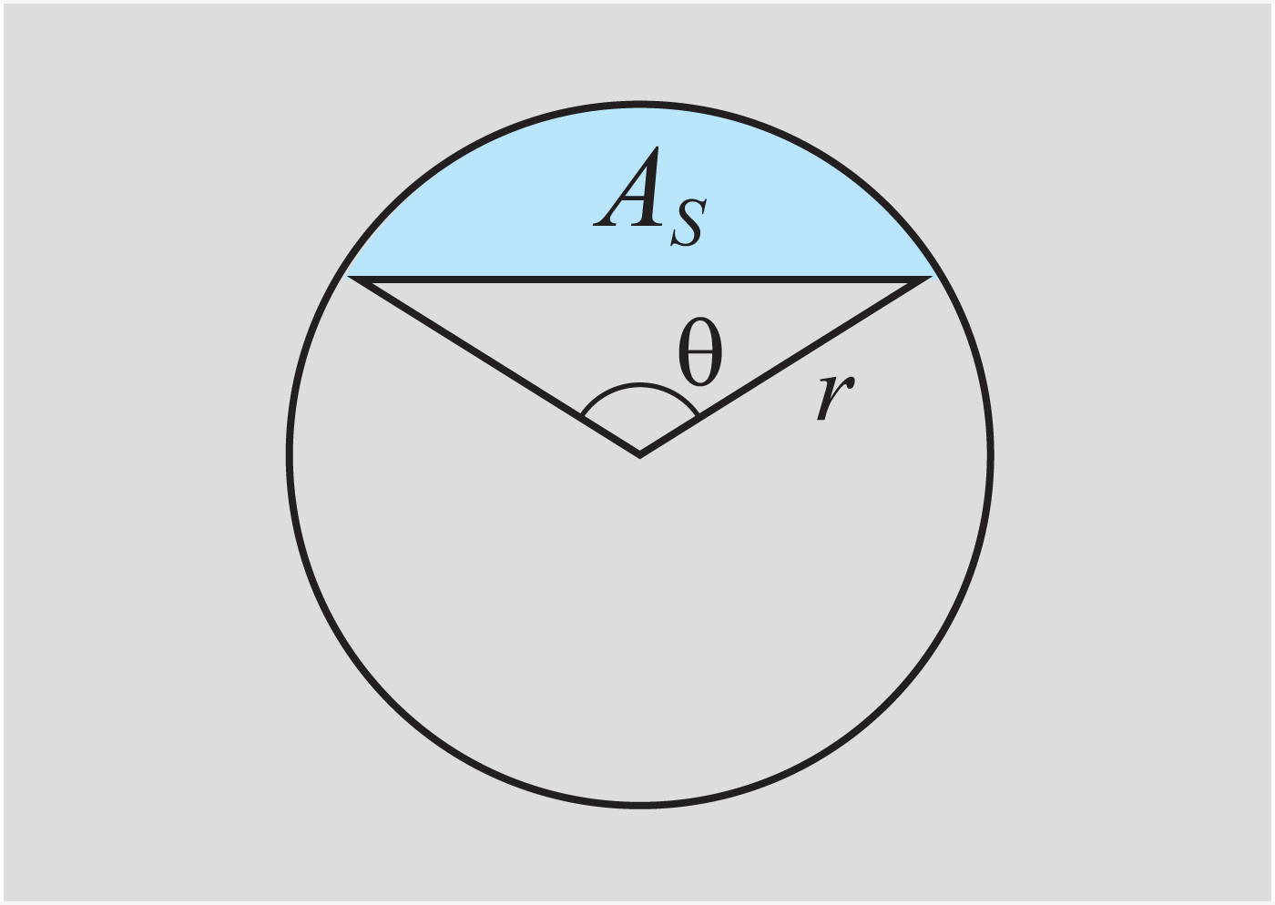
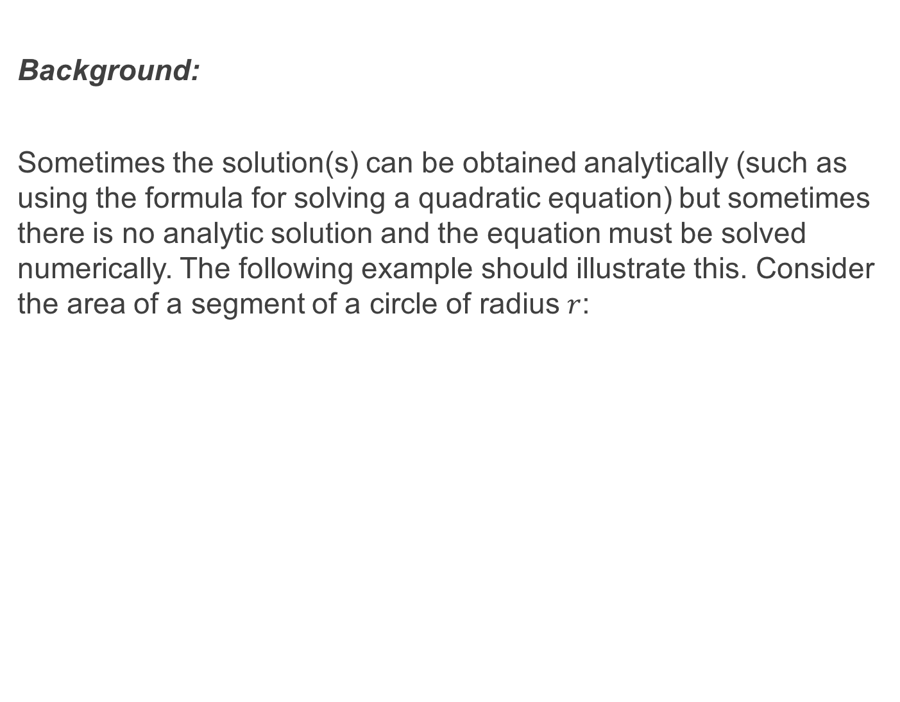
Background:
Sometimes the solution(s) can be obtained analytically (such as using the formula for solving a quadratic equation) but sometimes there is no analytic solution and the equation must be solved numerically. The following example should illustrate this. Consider the area of a segment of a circle of radius $r$:

Slide 5
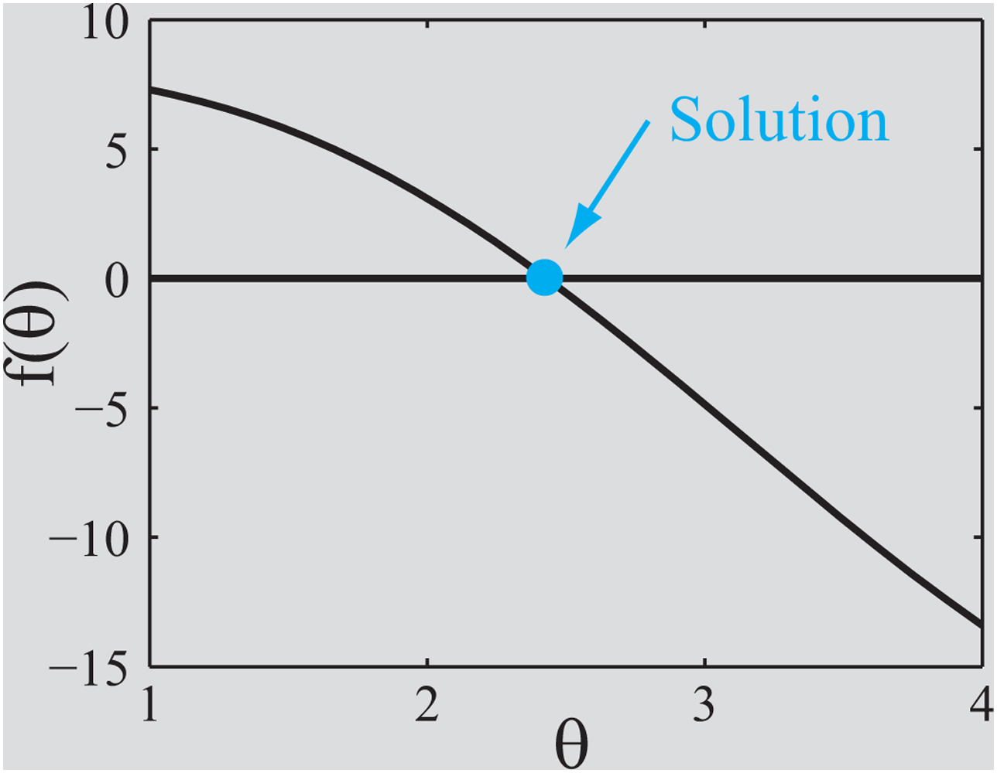
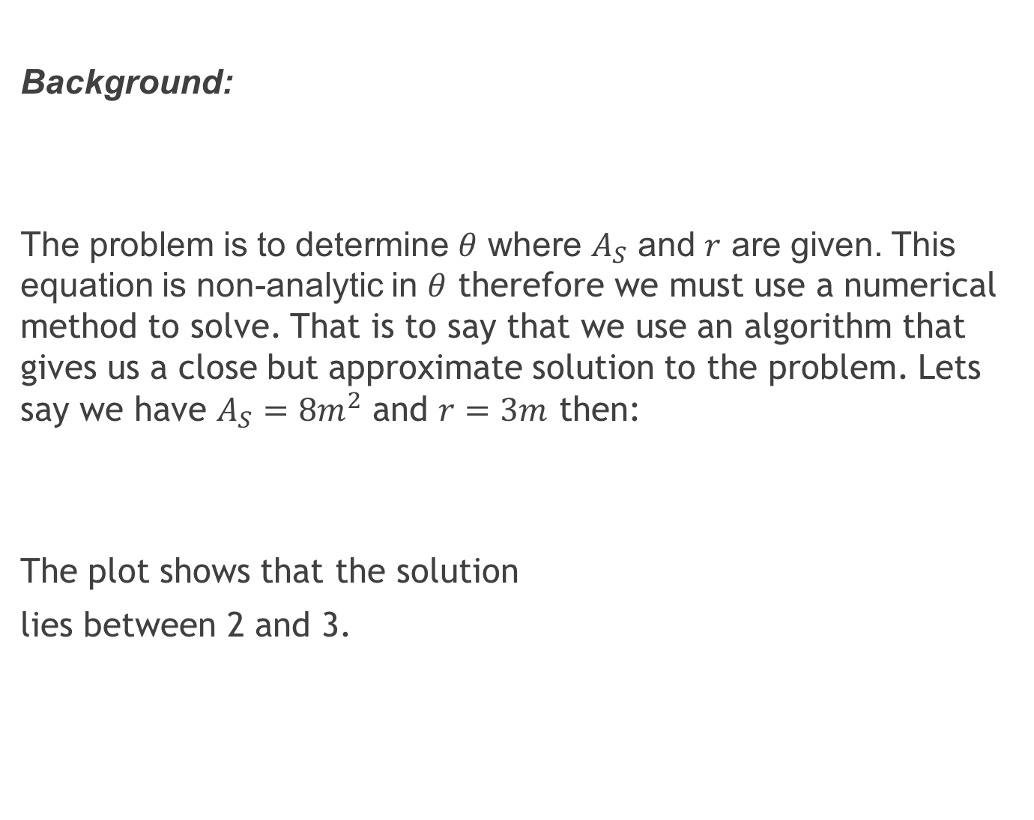
Background:
The problem is to determine $θ$ where $A_{S}$ and $r$ are given. This equation is non-analytic in $θ$ therefore we must use a numerical method to solve. That is to say that we use an algorithm that gives us a close but approximate solution to the problem. Lets say we have $A_{S}=8m^{2}$ and $r=3m$ then:
The plot shows that the solution
lies between 2 and 3.

Slide 6
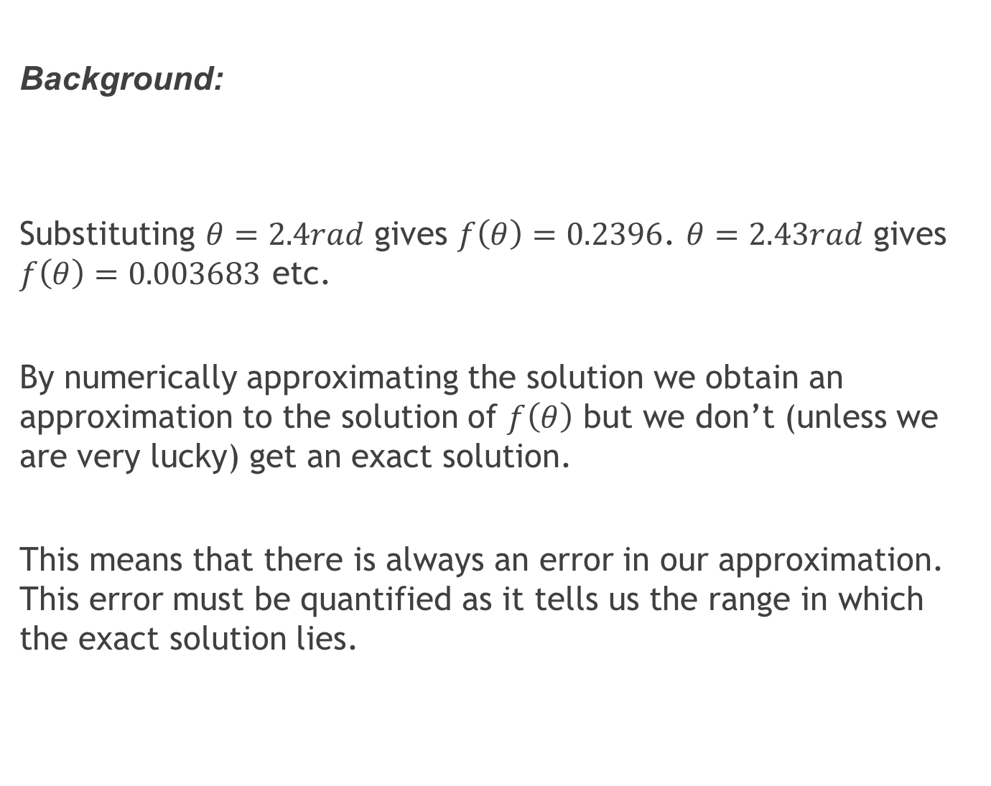
Background:
Substituting $θ=2.4rad$ gives $f\left(θ\right)=0.2396$. $θ=2.43rad$ gives $f\left(θ\right)=0.003683$ etc.
By numerically approximating the solution we obtain an approximation to the solution of $f\left(θ\right)$ but we don’t (unless we are very lucky) get an exact solution.
This means that there is always an error in our approximation. This error must be quantified as it tells us the range in which the exact solution lies.

Slide 7
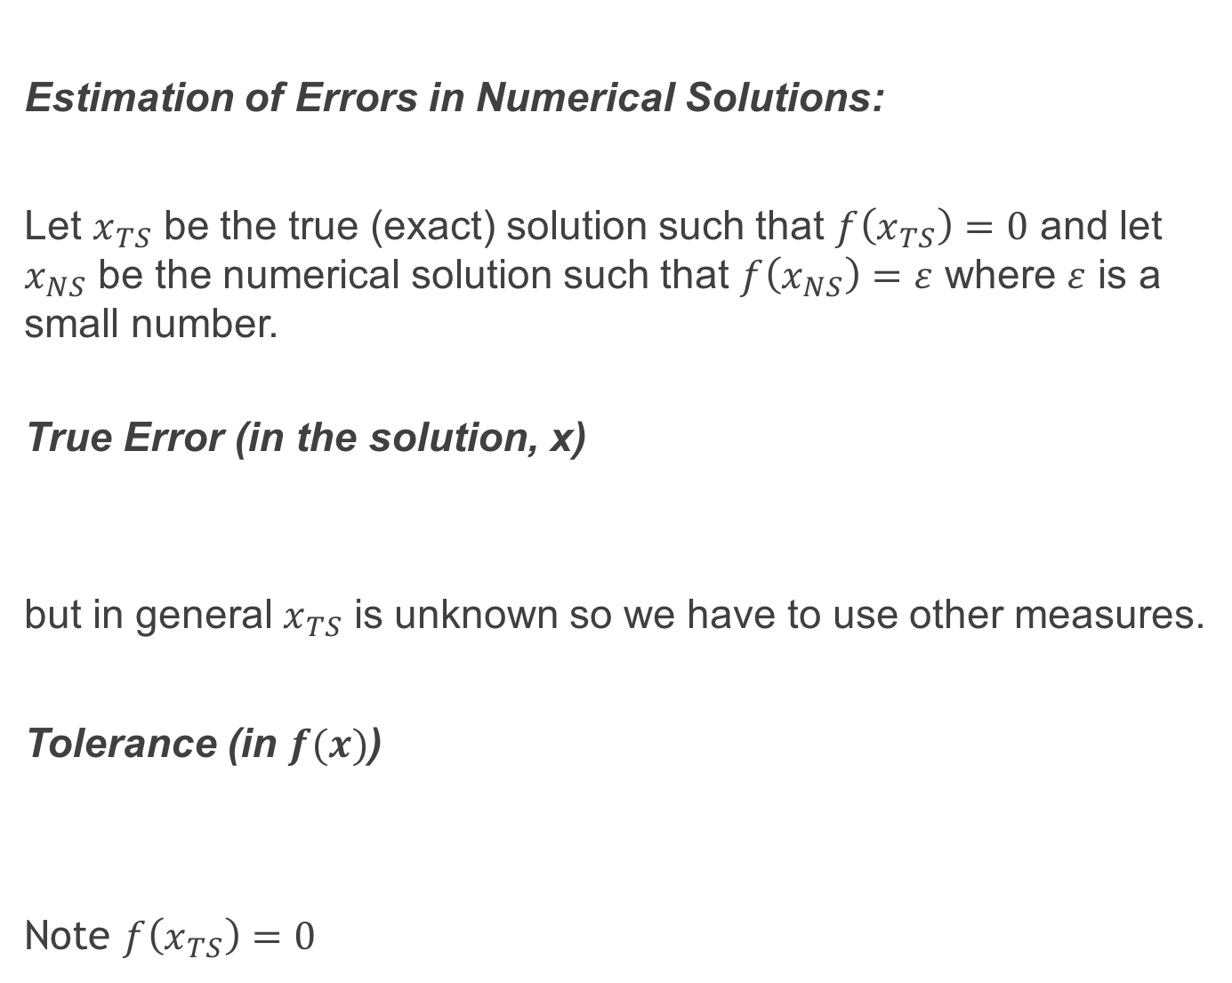
Estimation of Errors in Numerical Solutions:
Let $x_{TS}$ be the true (exact) solution such that $f\left(x_{TS}\right)=0$ and let $x_{NS}$ be the numerical solution such that $f\left(x_{NS}\right)=ε$ where $ε$ is a small number.
True Error (in the solution, x)
but in general $x_{TS}$ is unknown so we have to use other measures.
Tolerance (in $f(x)$)
Note $f\left(x_{TS}\right)=0$

Slide 8
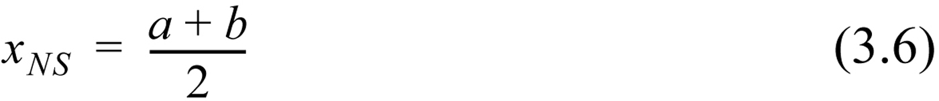
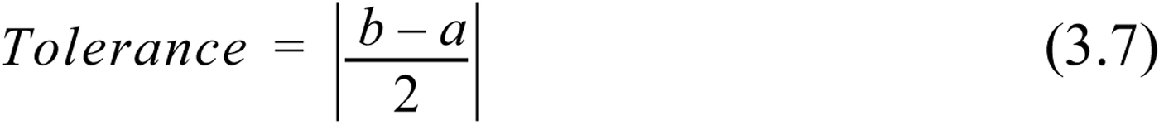
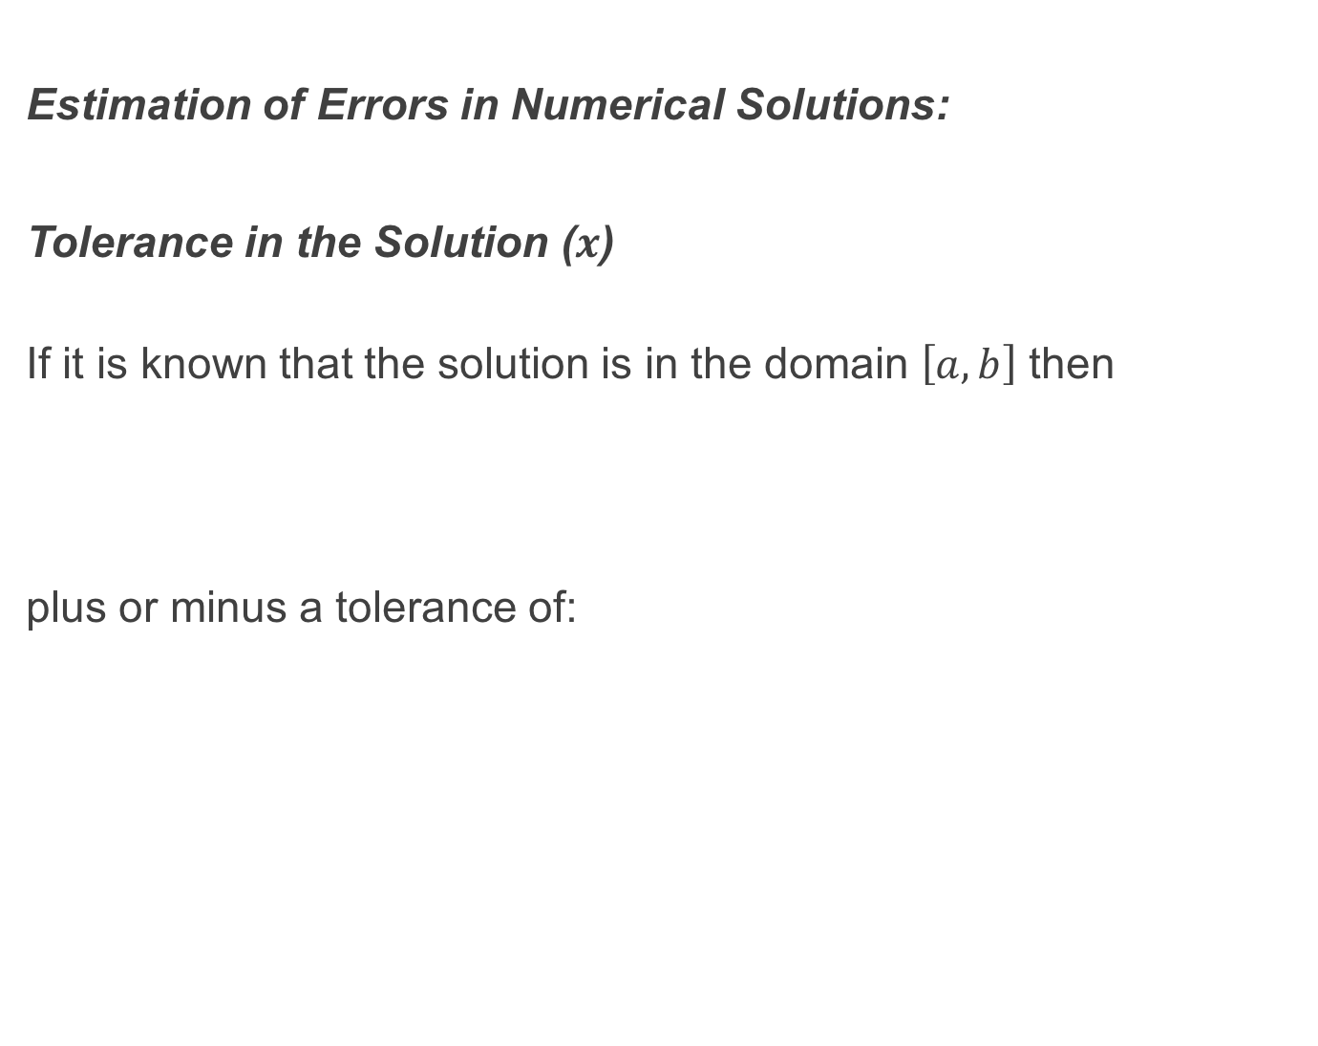
Estimation of Errors in Numerical Solutions:
Tolerance in the Solution ($x$)
If it is known that the solution is in the domain $\left[a,b\right]$ then
plus or minus a tolerance of:

Slide 9
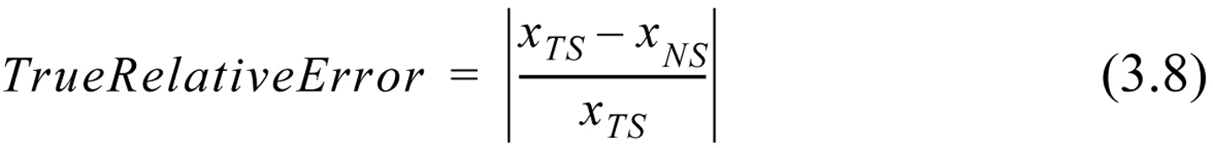
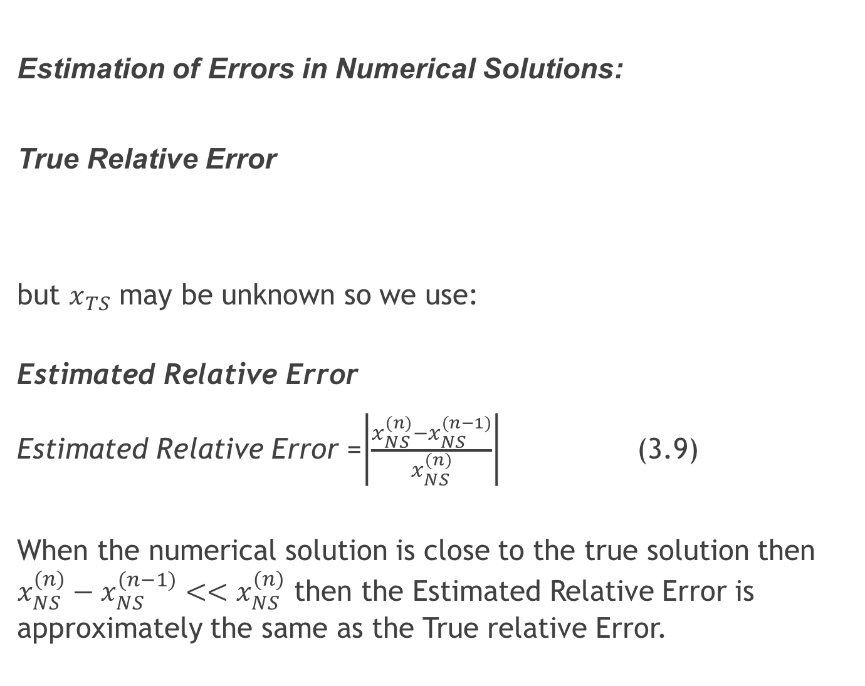
Estimation of Errors in Numerical Solutions:
True Relative Error
but $x_{TS}$ may be unknown so we use:
Estimated Relative Error
Estimated Relative Error =$\left|\frac{x_{NS}^{(n)}−x_{NS}^{(n−1)}}{x_{NS}^{(n)}}\right|$ (3.9)
When the numerical solution is close to the true solution then $x_{NS}^{(n)}−x_{NS}^{\left(n−1\right)}<<x_{NS}^{(n)}$ then the Estimated Relative Error is approximately the same as the True relative Error.

Slide 10
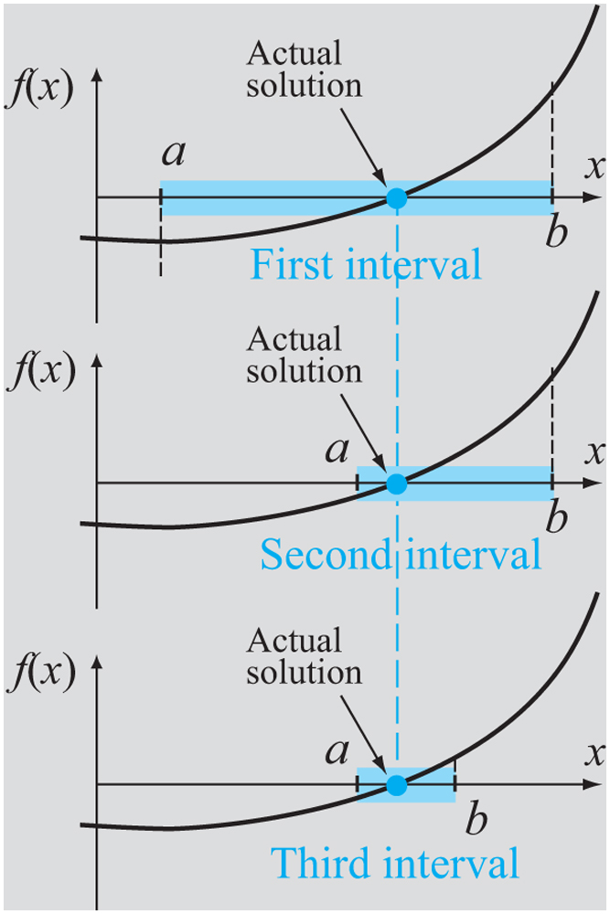
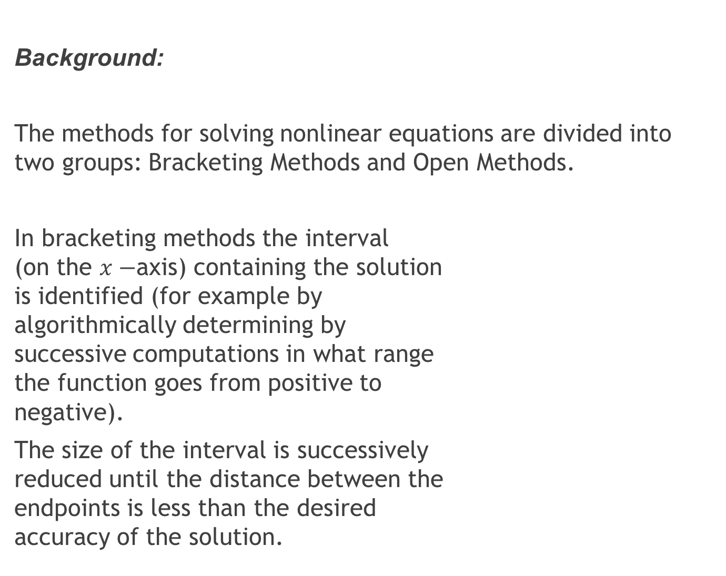
Background:
The methods for solving nonlinear equations are divided into two groups: Bracketing Methods and Open Methods.
In bracketing methods the interval (on the $x−$axis) containing the solution is identified (for example by algorithmically determining by successive computations in what range the function goes from positive to negative).
The size of the interval is successively reduced until the distance between the endpoints is less than the desired accuracy of the solution.

Slide 11
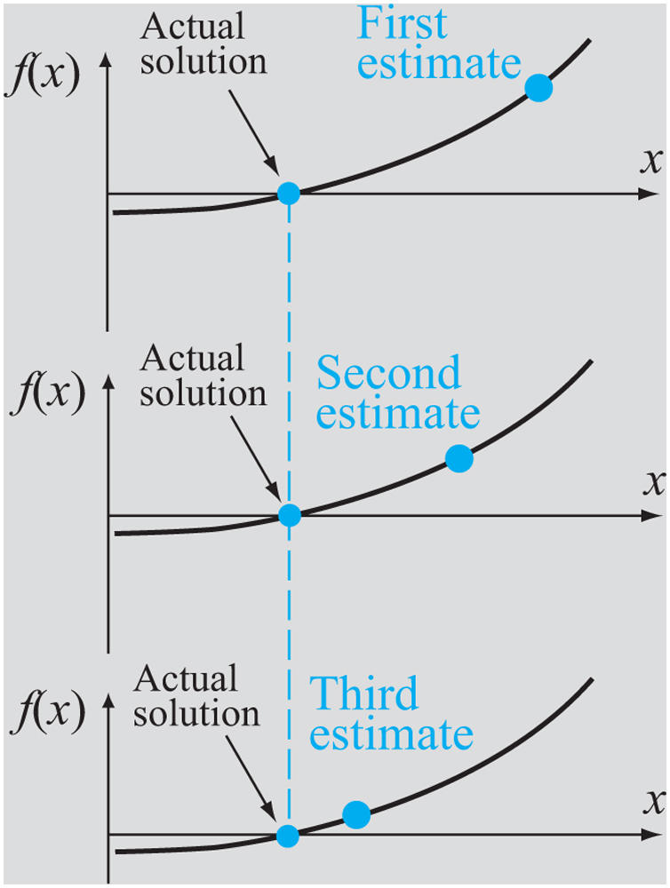
Background:
Open methods achieve this goal by making an initial guess at the solution and narrow down the search through further guesswork discarding solutions that have a higher error than that currently in hand and directing the search so that we get a smaller error.
Open methods are more efficient but may not yield a solution. Bracketing methods on the other hand always converge to a solution

Slide 12
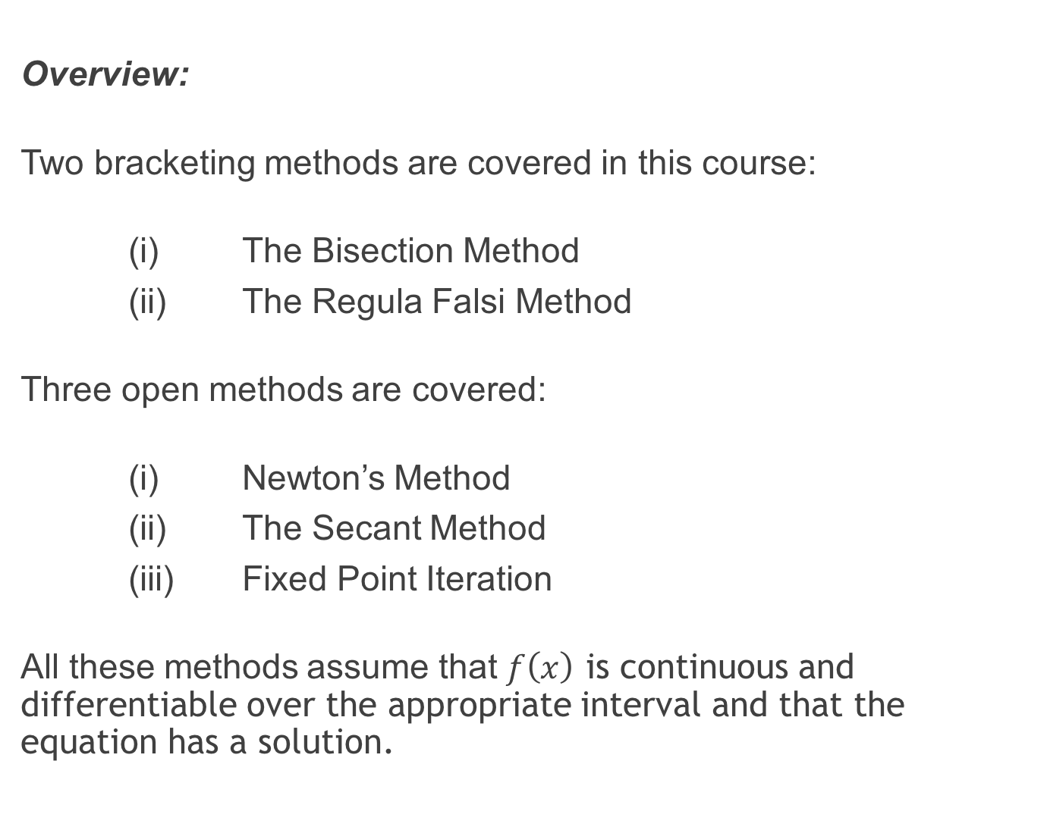
Overview:
Two bracketing methods are covered in this course:
(i) The Bisection Method
(ii) The Regula Falsi Method
Three open methods are covered:
(i) Newton’s Method
(ii) The Secant Method
(iii) Fixed Point Iteration
All these methods assume that $f\left(x\right)$ is continuous and differentiable over the appropriate interval and that the equation has a solution.

Slide 13
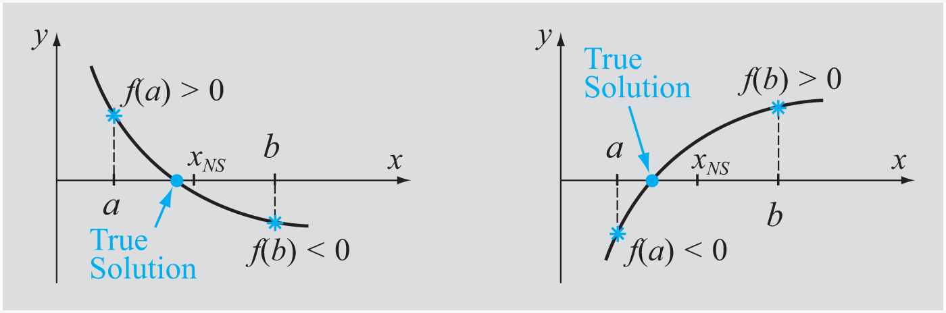
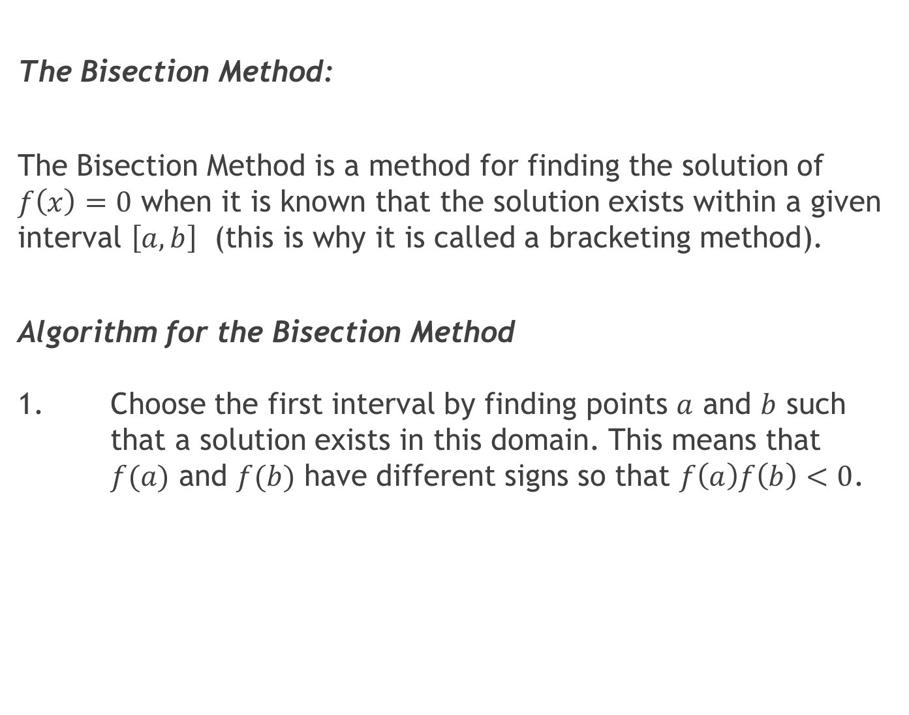
The Bisection Method:
The Bisection Method is a method for finding the solution of $f\left(x\right)=0$ when it is known that the solution exists within a given interval $\left[a,b\right]$ (this is why it is called a bracketing method).
Algorithm for the Bisection Method 1. Choose the first interval by finding points $a$ and $b$ such that a solution exists in this domain. This means that $f(a)$ and $f(b)$ have different signs so that $f\left(a\right)f\left(b\right)<0$.

Slide 14
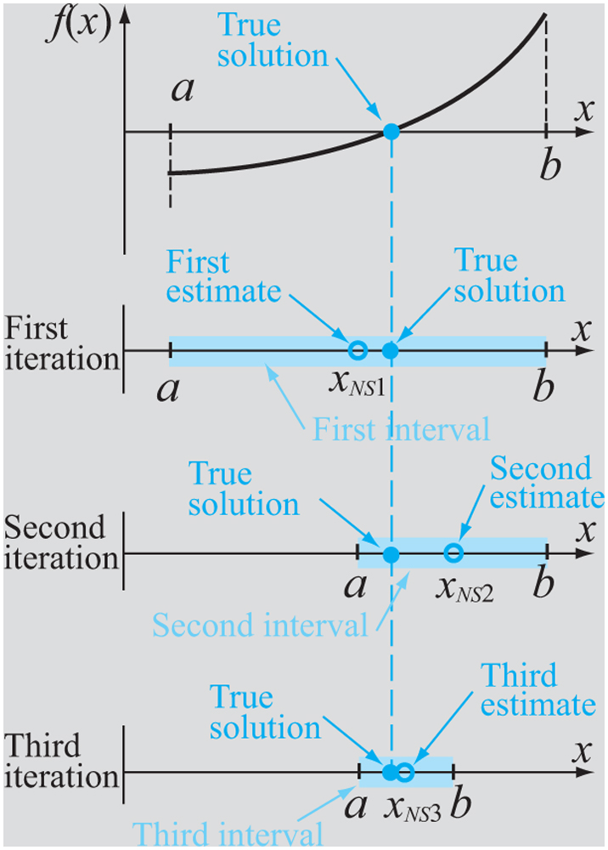
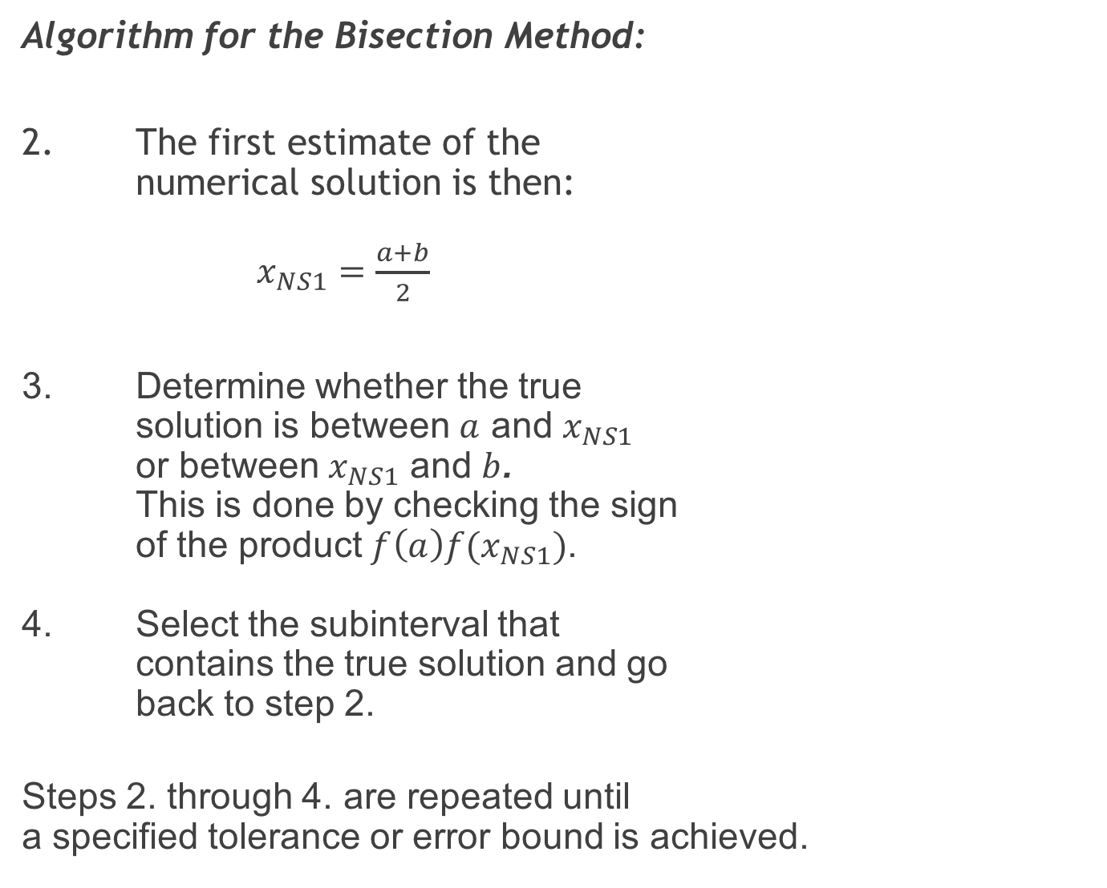
Algorithm for the Bisection Method:
2. The first estimate of the numerical solution is then: $x_{NS1}=\frac{a+b}{2}$
3. Determine whether the true solution is between $a$ and $x_{NS1}$ or between $x_{NS1}$ and $b$. This is done by checking the sign of the product $f\left(a\right)f(x_{NS1})$. 4. Select the subinterval that contains the true solution and go back to step 2.
Steps 2. through 4. are repeated until a specified tolerance or error bound is achieved.

Slide 15
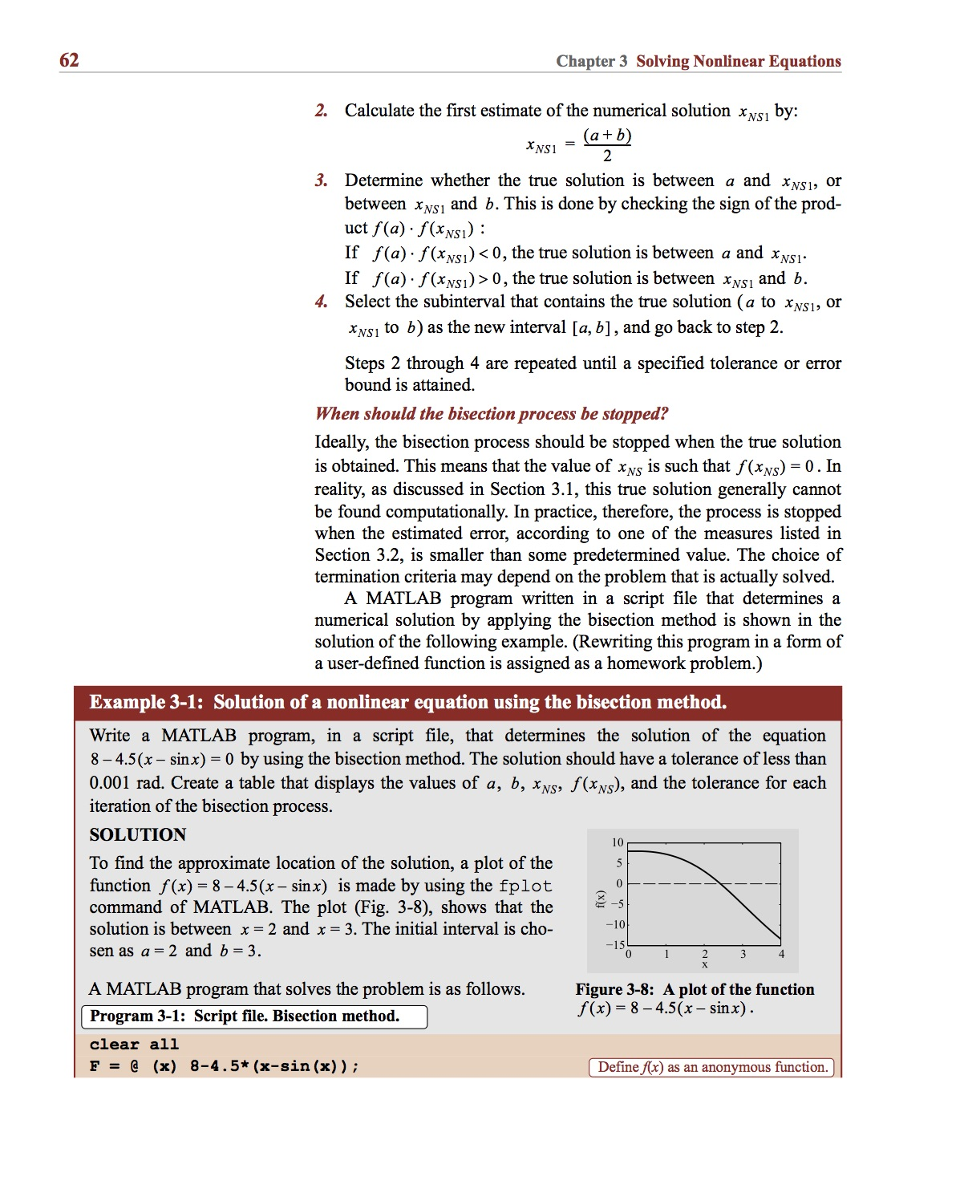
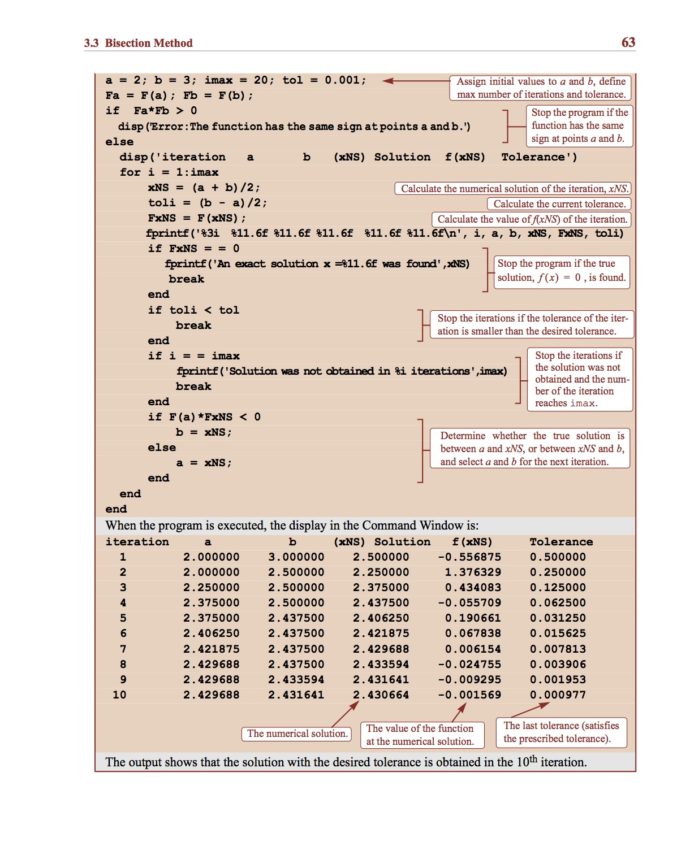
Example:

Slide 16
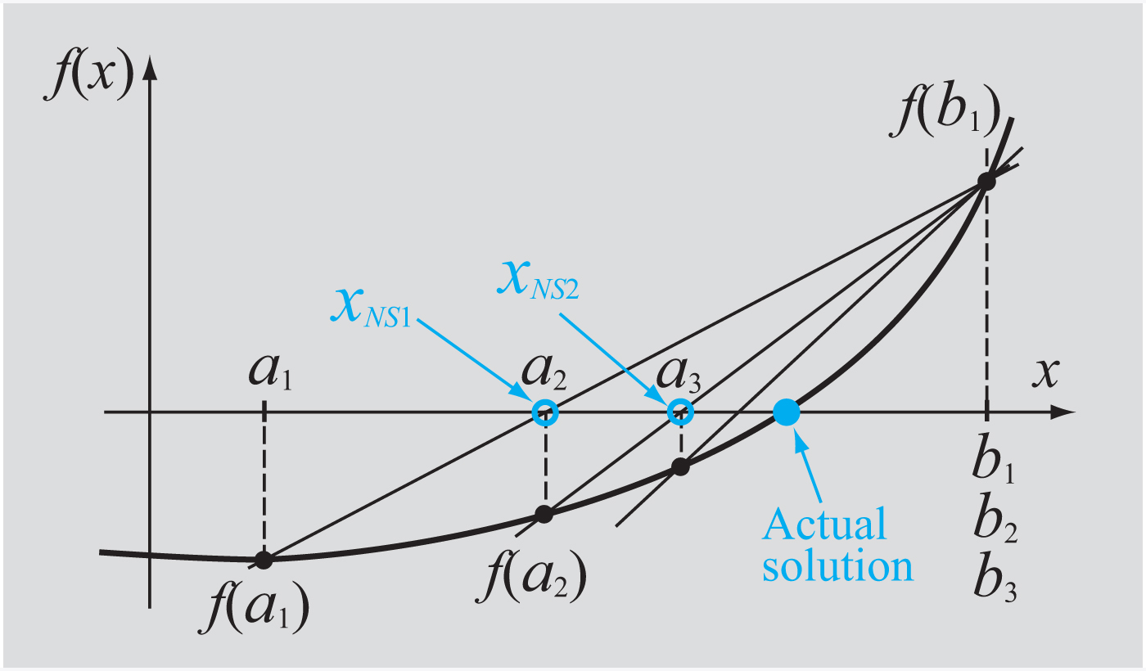
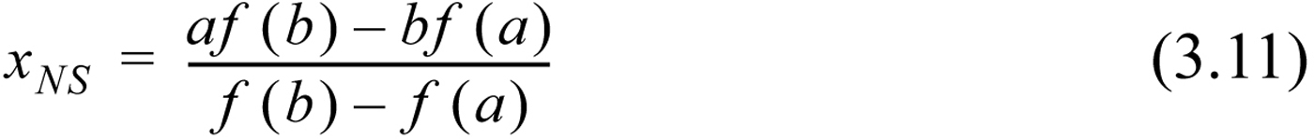
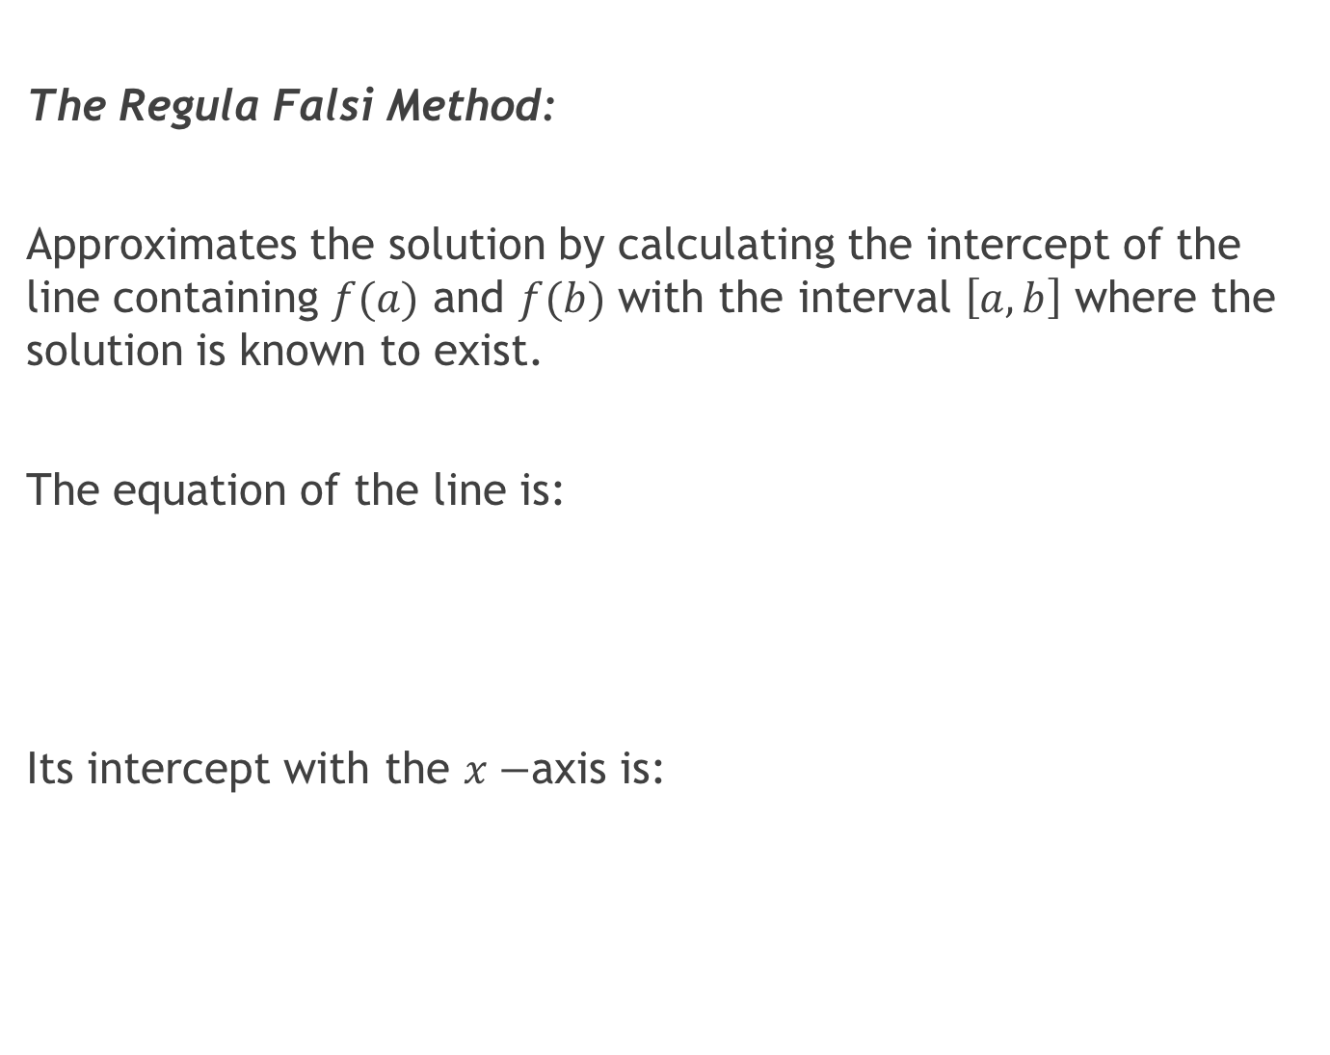
The Regula Falsi Method:
Approximates the solution by calculating the intercept of the line containing $f(a)$ and $f(b)$ with the interval $\left[a,b\right]$ where the solution is known to exist.
The equation of the line is:
Its intercept with the $x−$axis is:

Slide 17
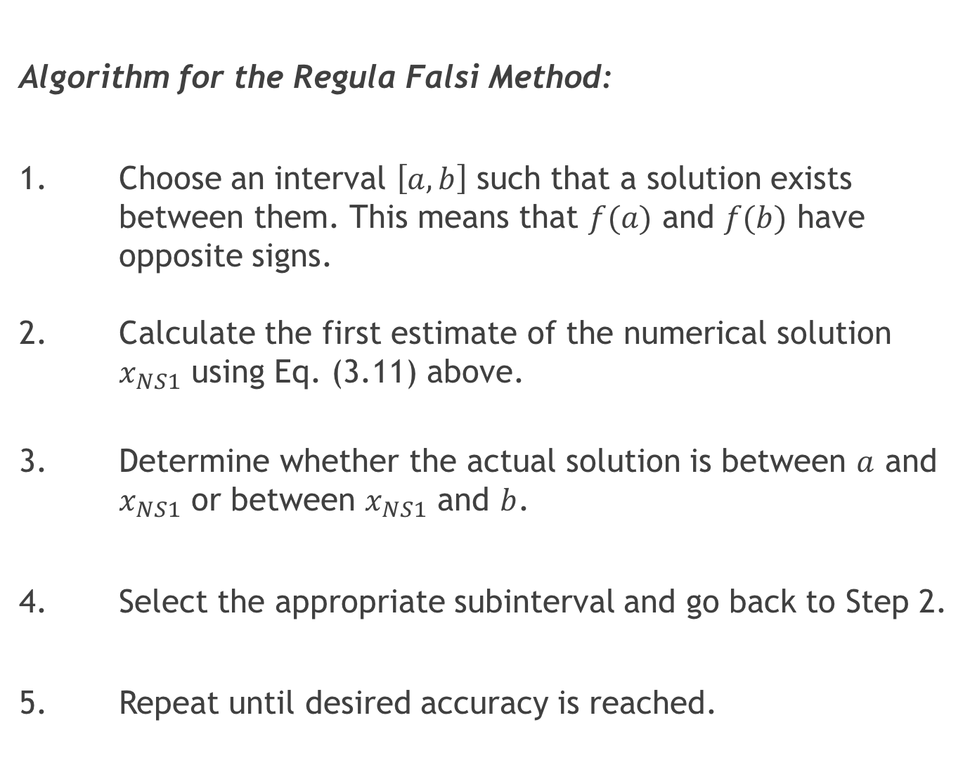
Algorithm for the Regula Falsi Method:
1. Choose an interval $\left[a,b\right]$ such that a solution exists between them. This means that $f(a)$ and $f(b)$ have opposite signs. 2. Calculate the first estimate of the numerical solution $x_{NS1}$ using Eq. (3.11) above.
3. Determine whether the actual solution is between $a$ and $x_{NS1}$ or between $x_{NS1}$ and $b$.
4. Select the appropriate subinterval and go back to Step 2.
5. Repeat until desired accuracy is reached.

Slide 18
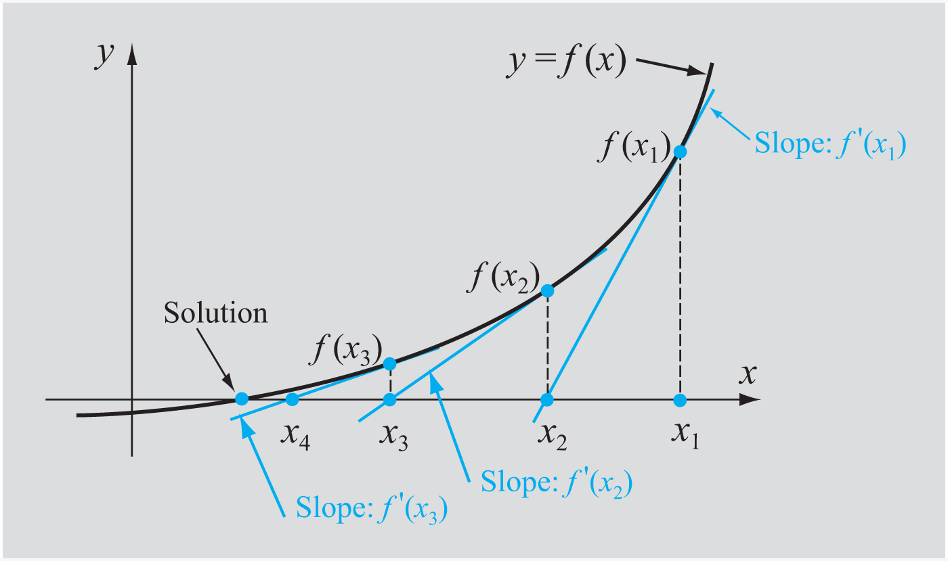
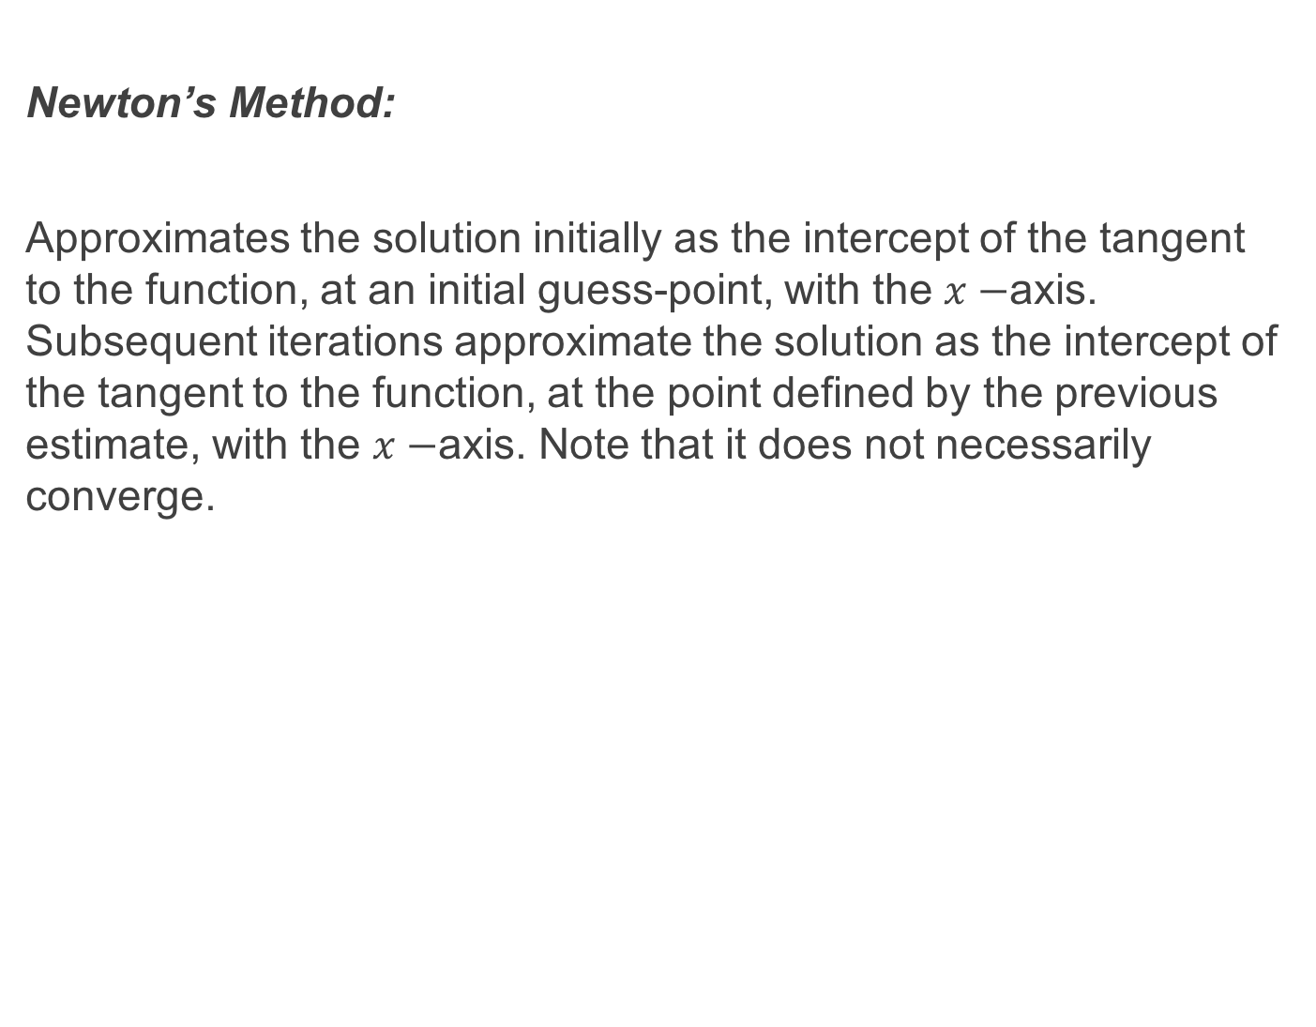
Newton’s Method:
Approximates the solution initially as the intercept of the tangent to the function, at an initial guess-point, with the $x−$axis. Subsequent iterations approximate the solution as the intercept of the tangent to the function, at the point defined by the previous estimate, with the $x−$axis. Note that it does not necessarily converge.

Slide 19
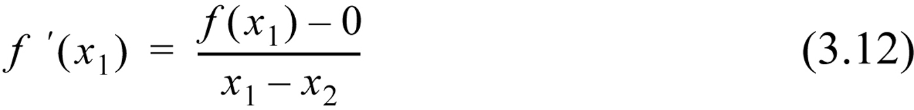
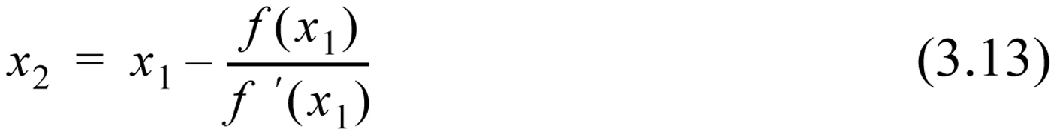
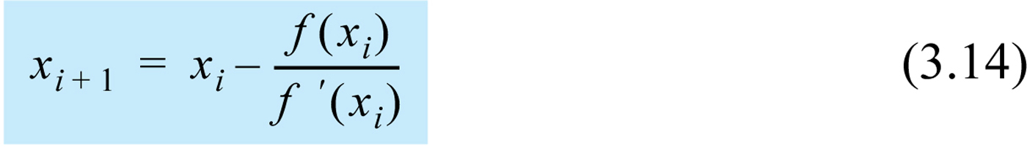
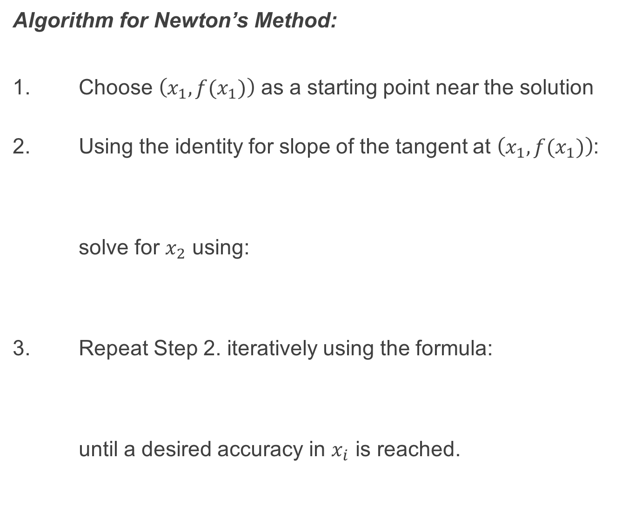
Algorithm for Newton’s Method:
1. Choose $\left(x_{1},f(x_{1})\right)$ as a starting point near the solution
2. Using the identity for slope of the tangent at $\left(x_{1},f(x_{1})\right)$:
solve for $x_{2}$ using:
3. Repeat Step 2. iteratively using the formula:
until a desired accuracy in $x_{i}$ is reached.

Slide 20
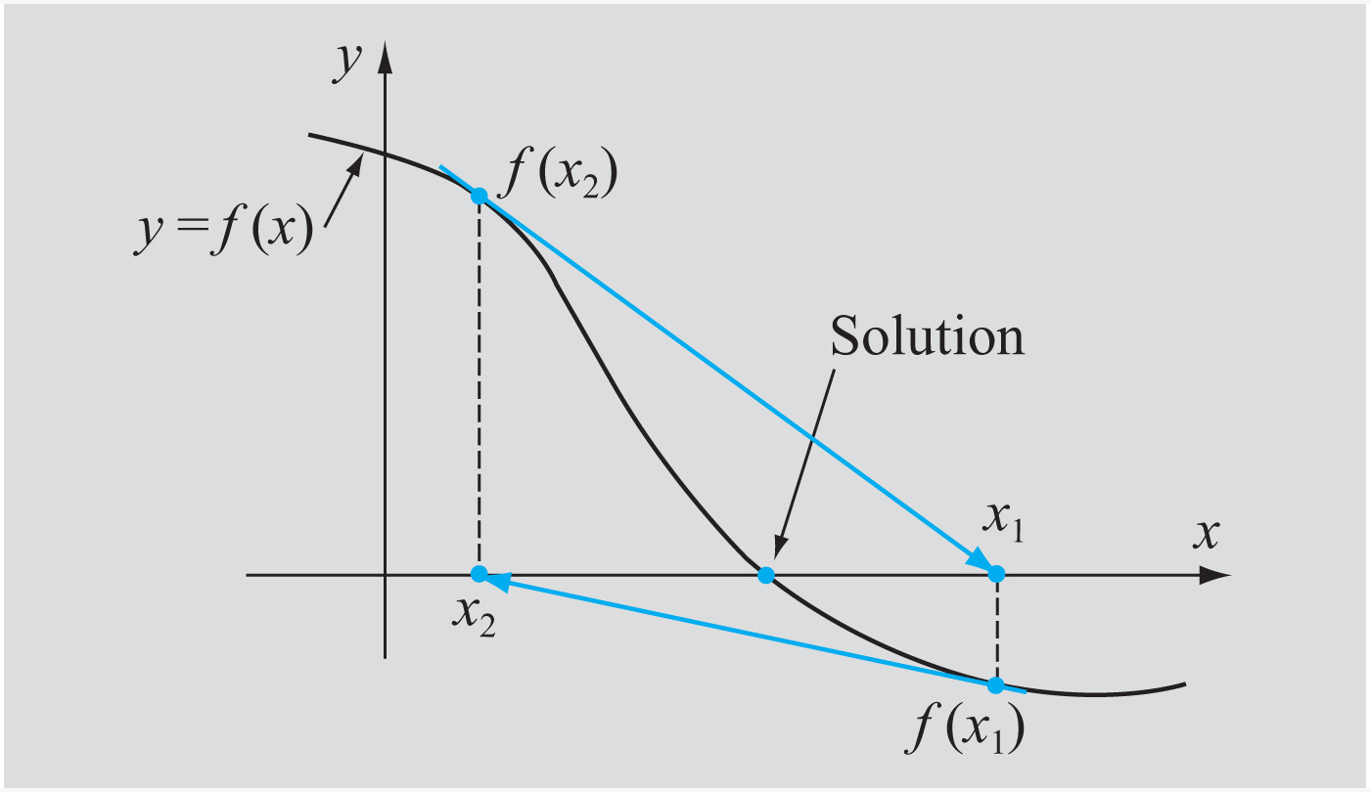
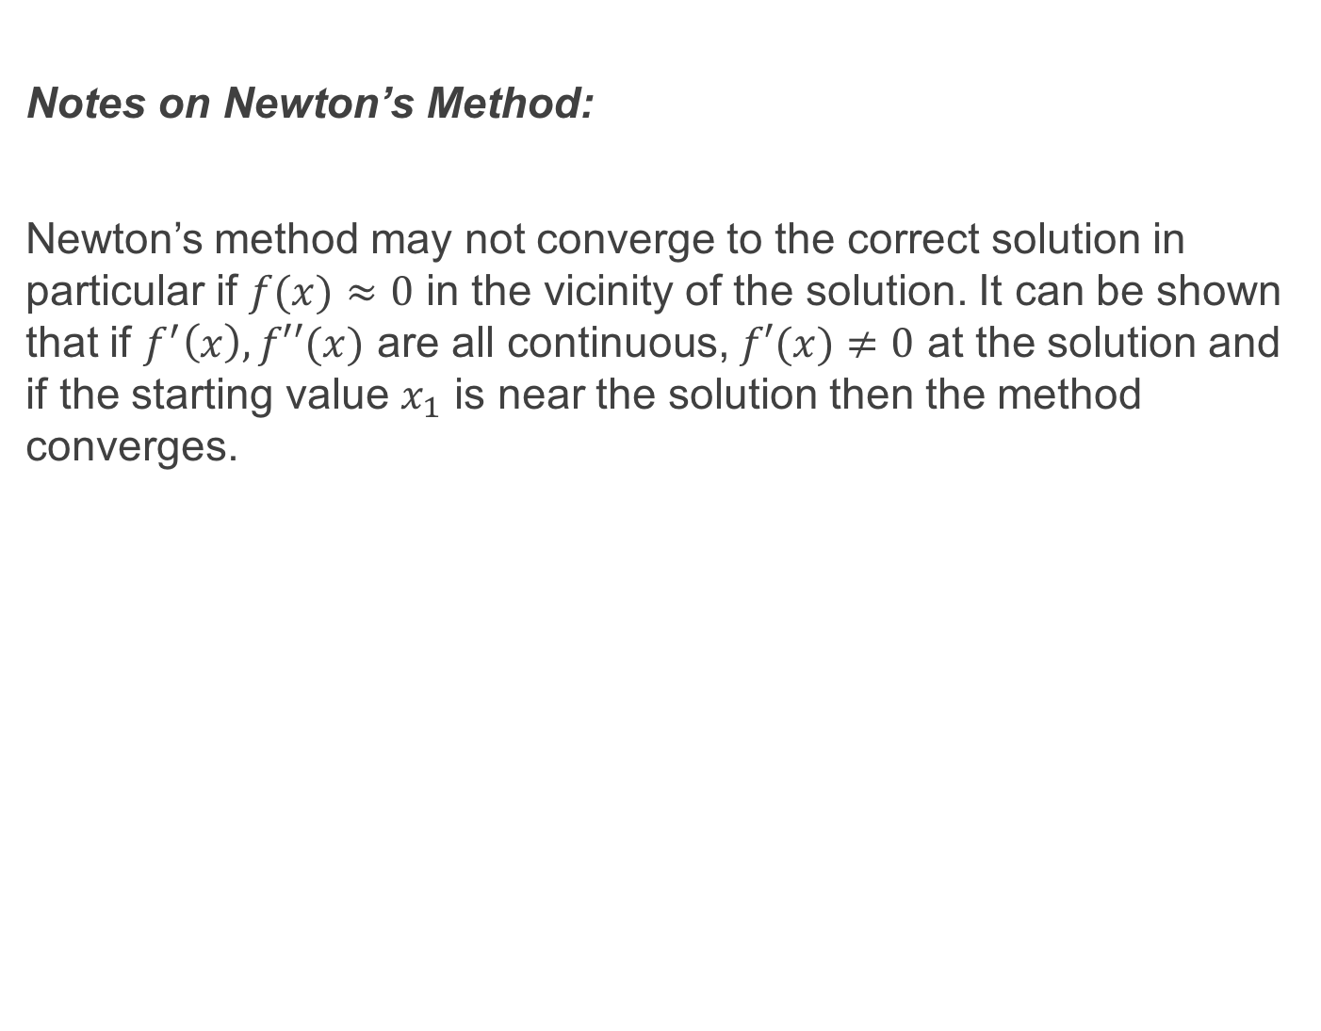
Notes on Newton’s Method:
Newton’s method may not converge to the correct solution in particular if $f(x)≈0$ in the vicinity of the solution. It can be shown that if $f^{′}\left(x\right), f′′(x)$ are all continuous, $f′(x)≠0$ at the solution and if the starting value $x_{1}$ is near the solution then the method converges.

Slide 21
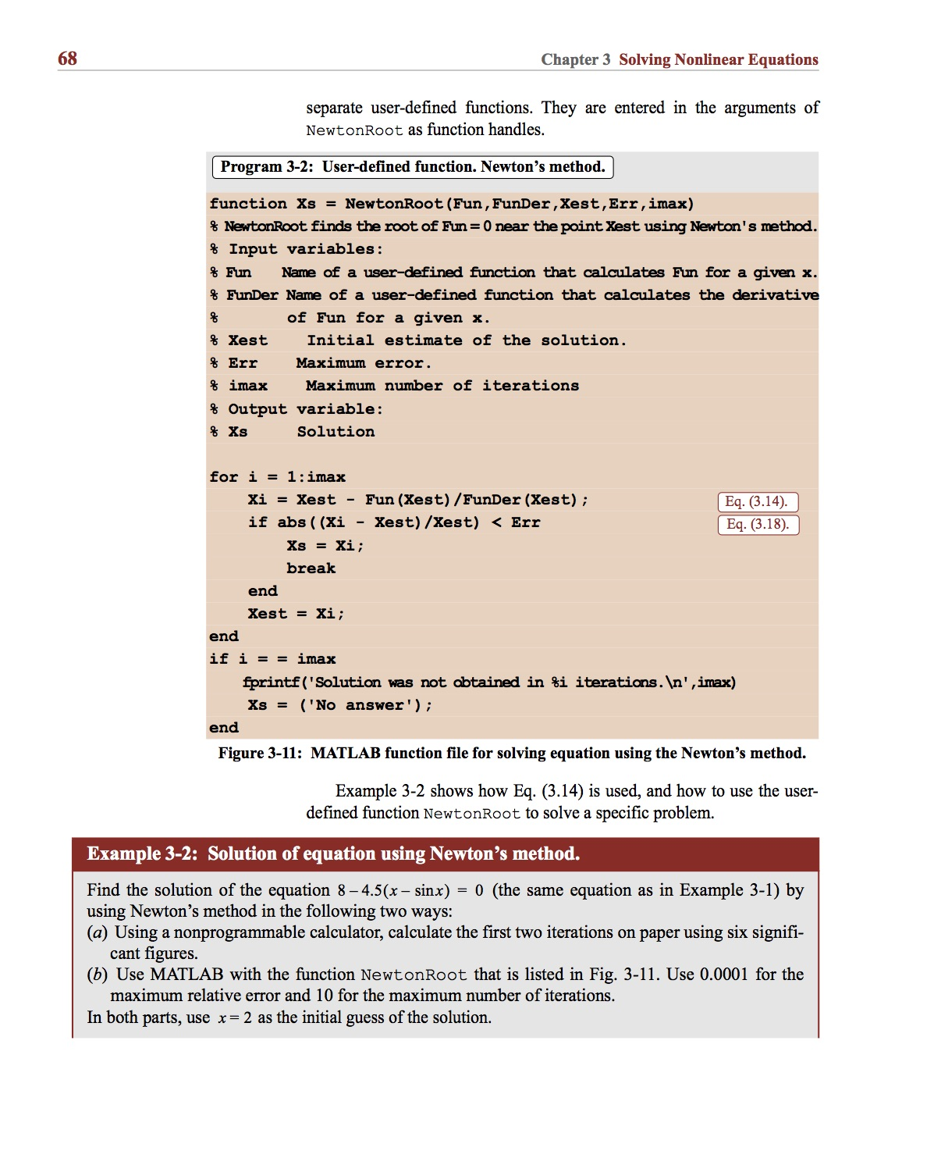
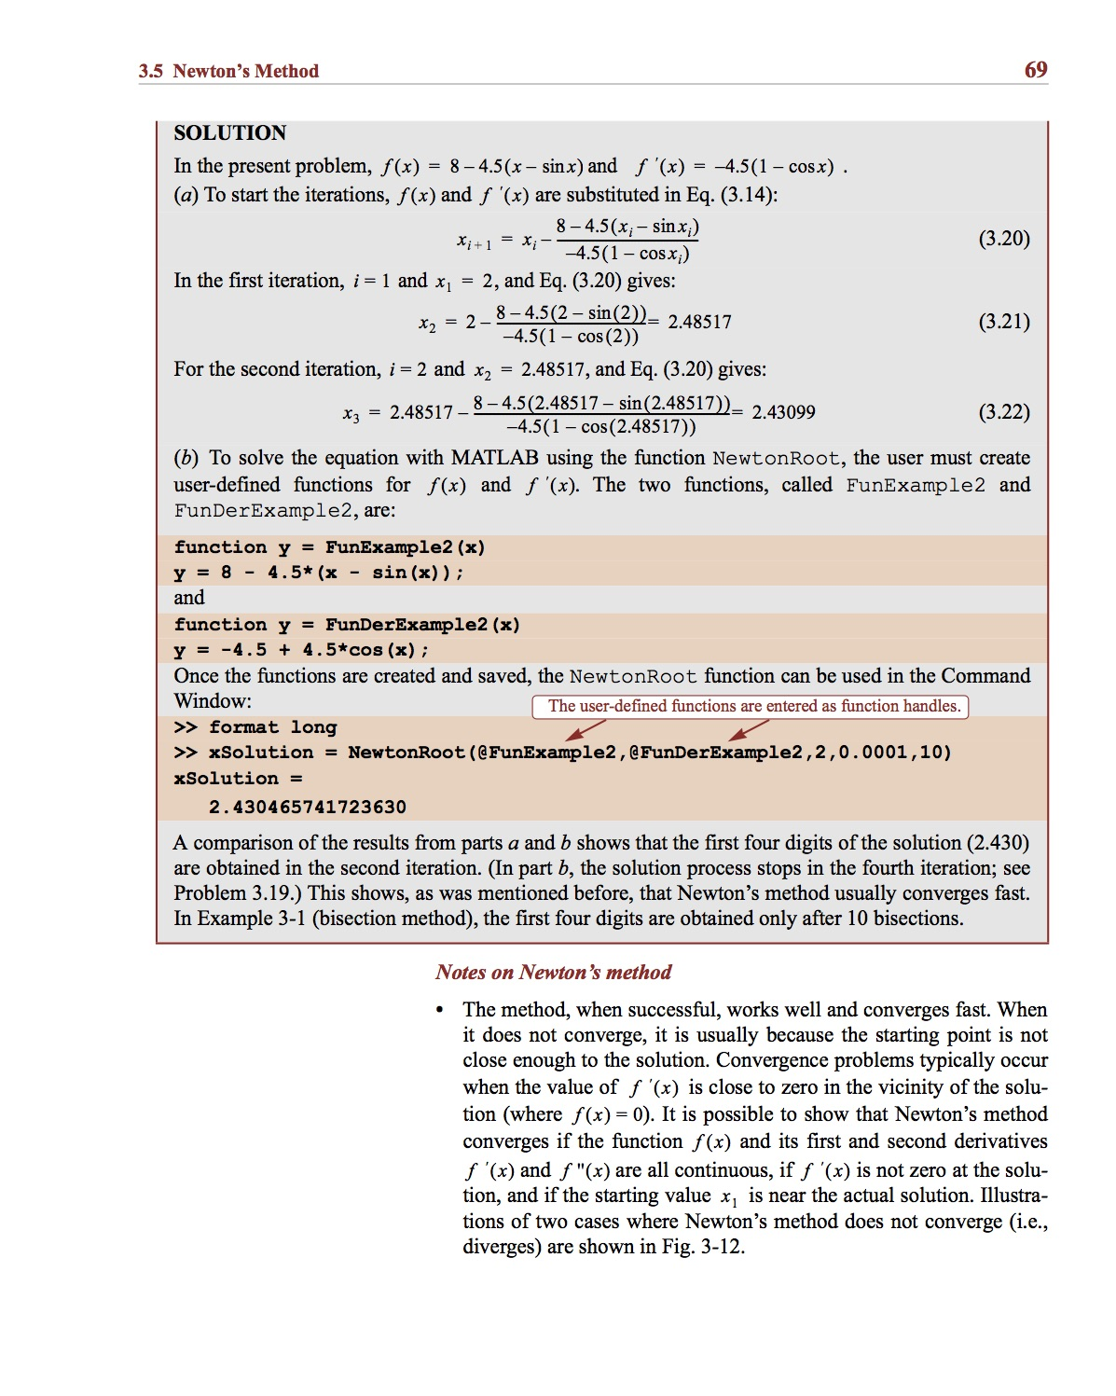
Example:

Slide 22
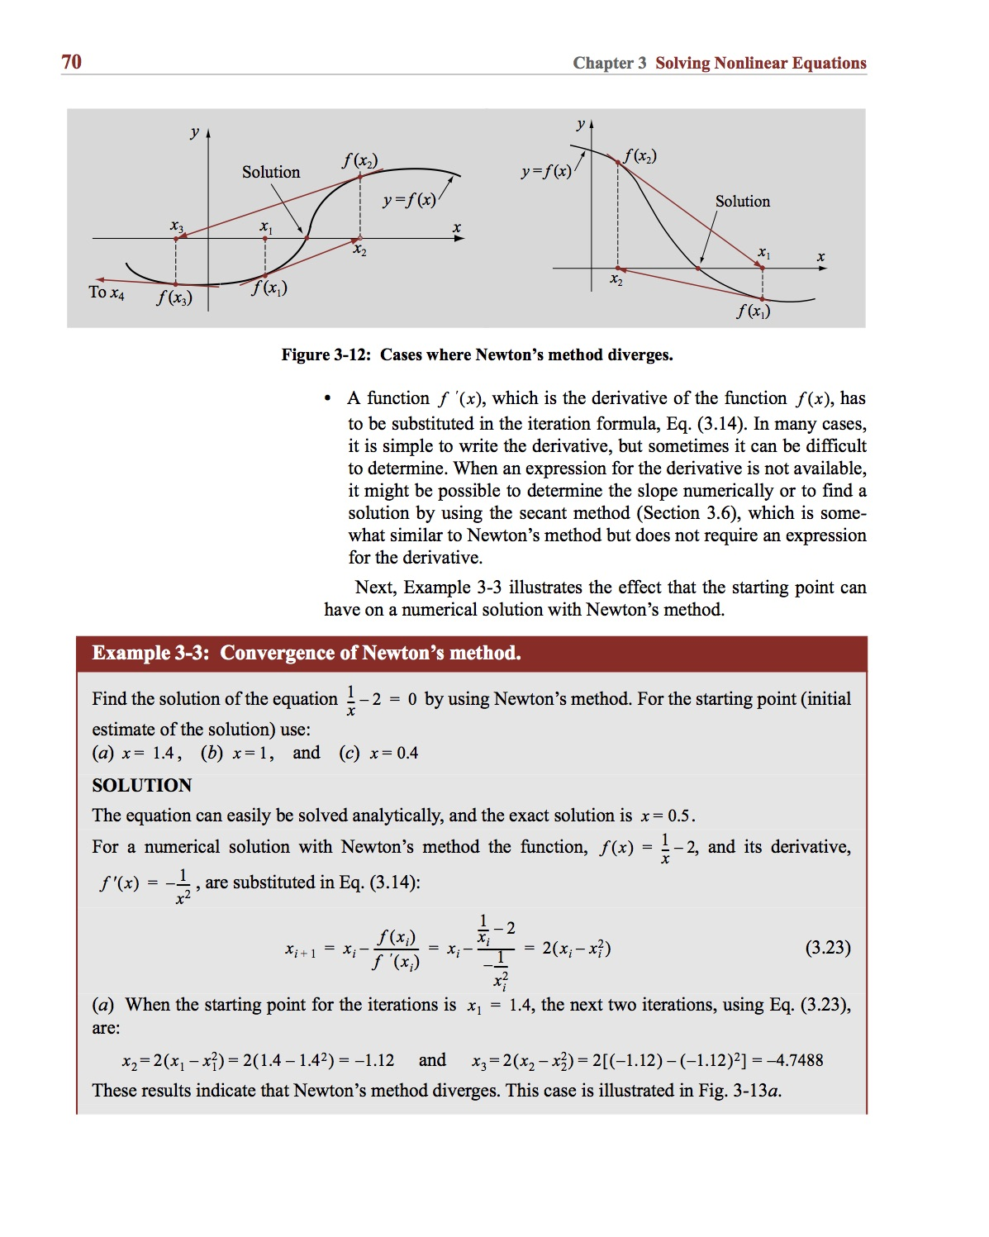
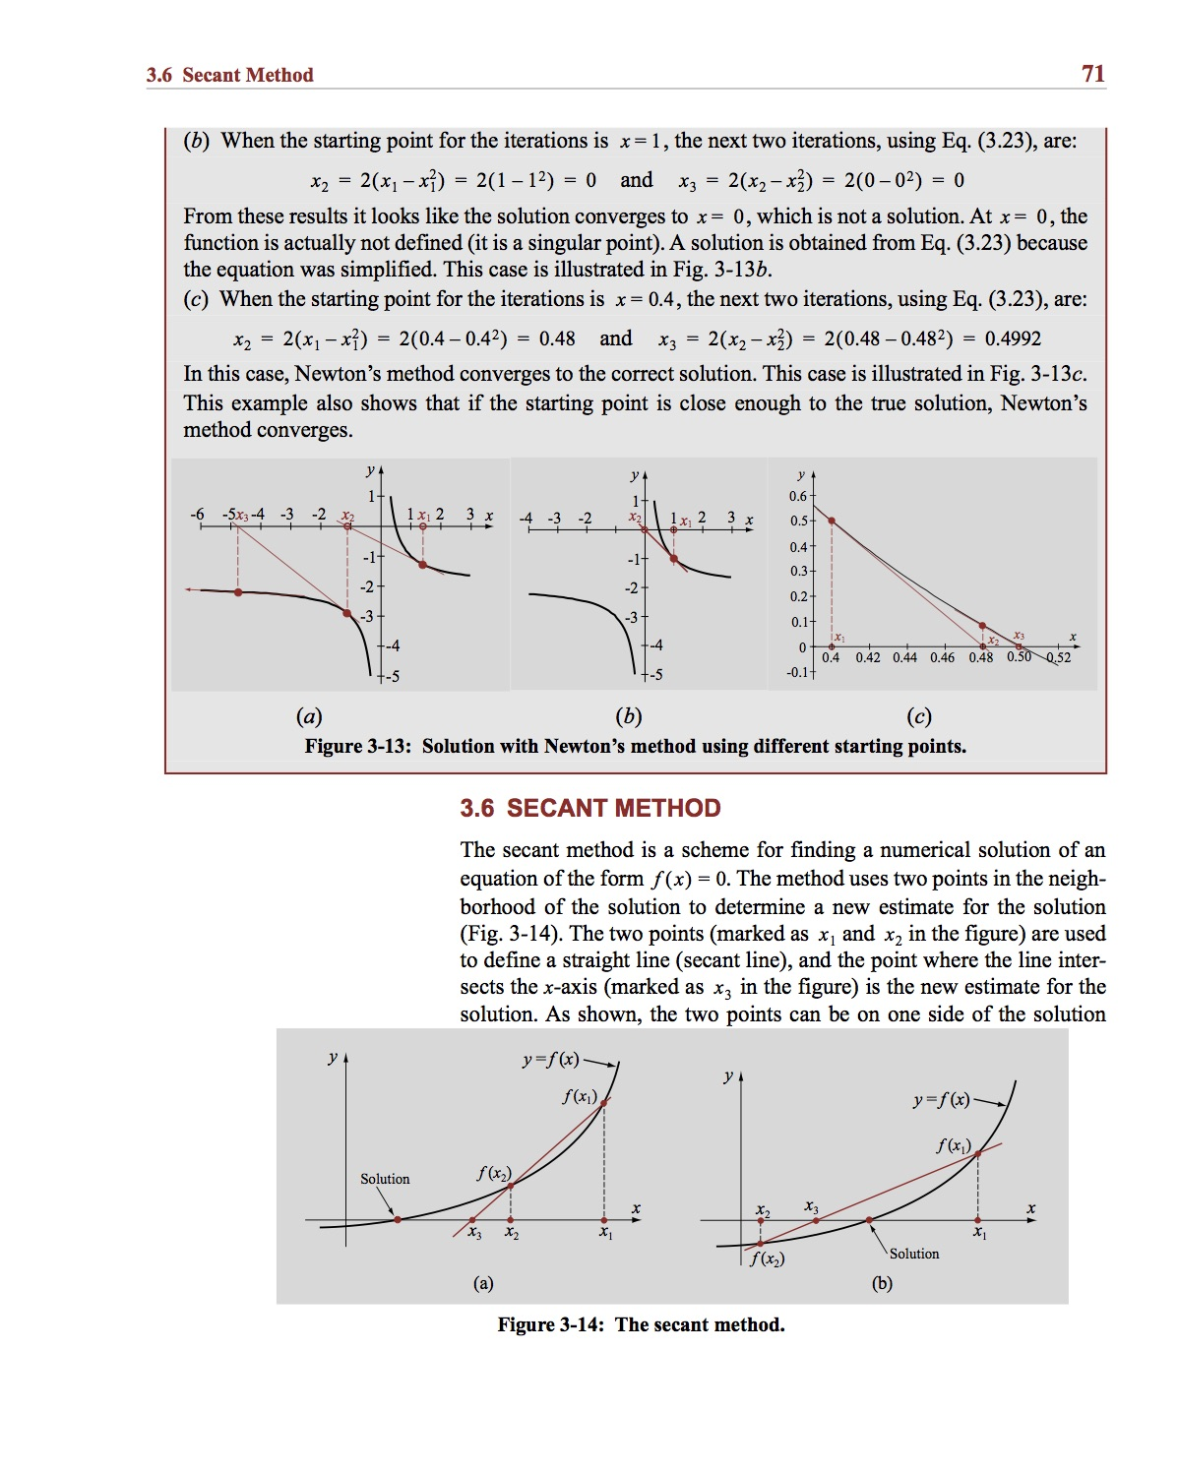
Example:

Slide 23
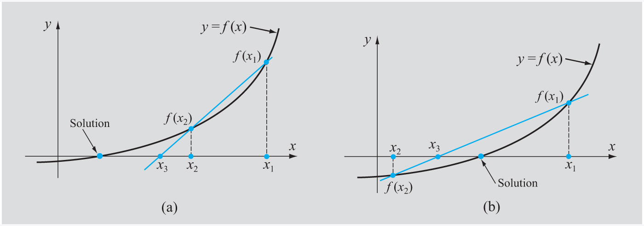
The Secant Method:
Same idea as Newton’s Method but instead we use a secant to the function instead of a tangent. This means that we initially need two points in the neighbourhood of the solution to begin with.

Slide 24
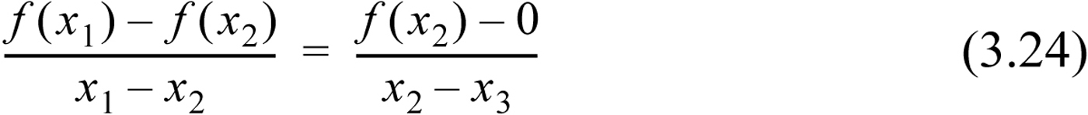
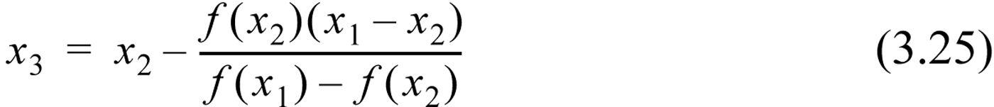
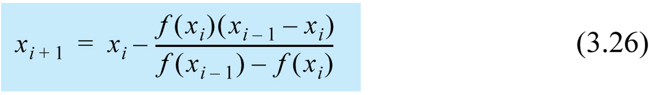
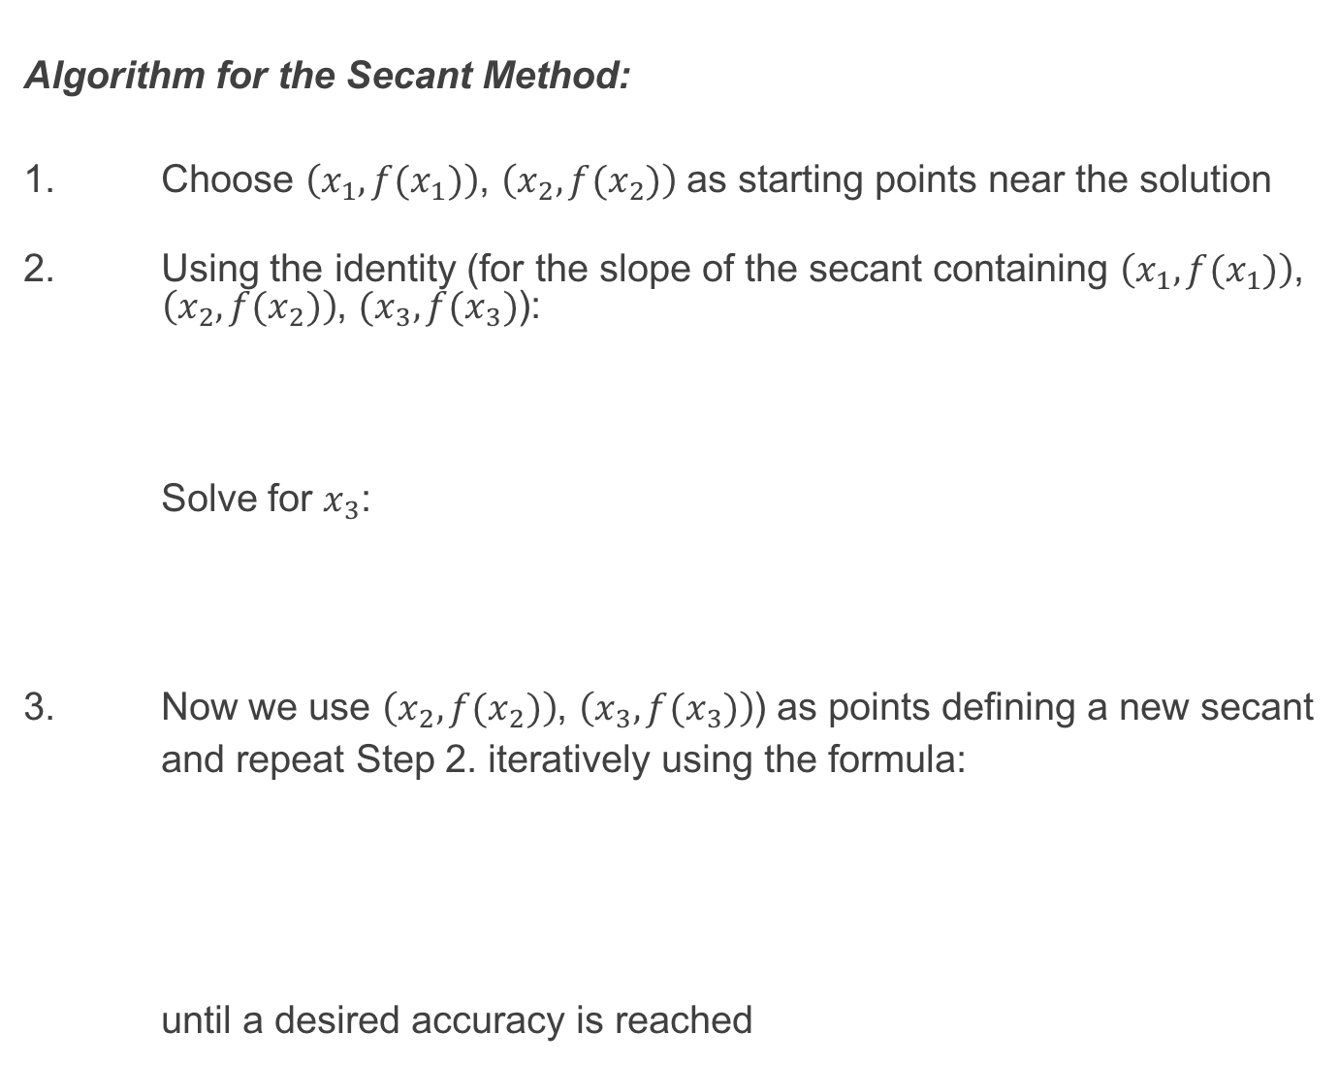
Algorithm for the Secant Method:
1. Choose $\left(x_{1},f(x_{1})\right)$, $\left(x_{2},f(x_{2})\right)$ as starting points near the solution
2. Using the identity (for the slope of the secant containing $\left(x_{1},f(x_{1})\right)$, $\left(x_{2},f(x_{2})\right)$, $(x_{3},f(x_{3})$):
Solve for $x_{3}$:
3. Now we use $\left(x_{2},f(x_{2})\right)$, $\left(x_{3},f(x_{3})\right)$) as points defining a new secant
and repeat Step 2. iteratively using the formula:
until a desired accuracy is reached

Slide 25
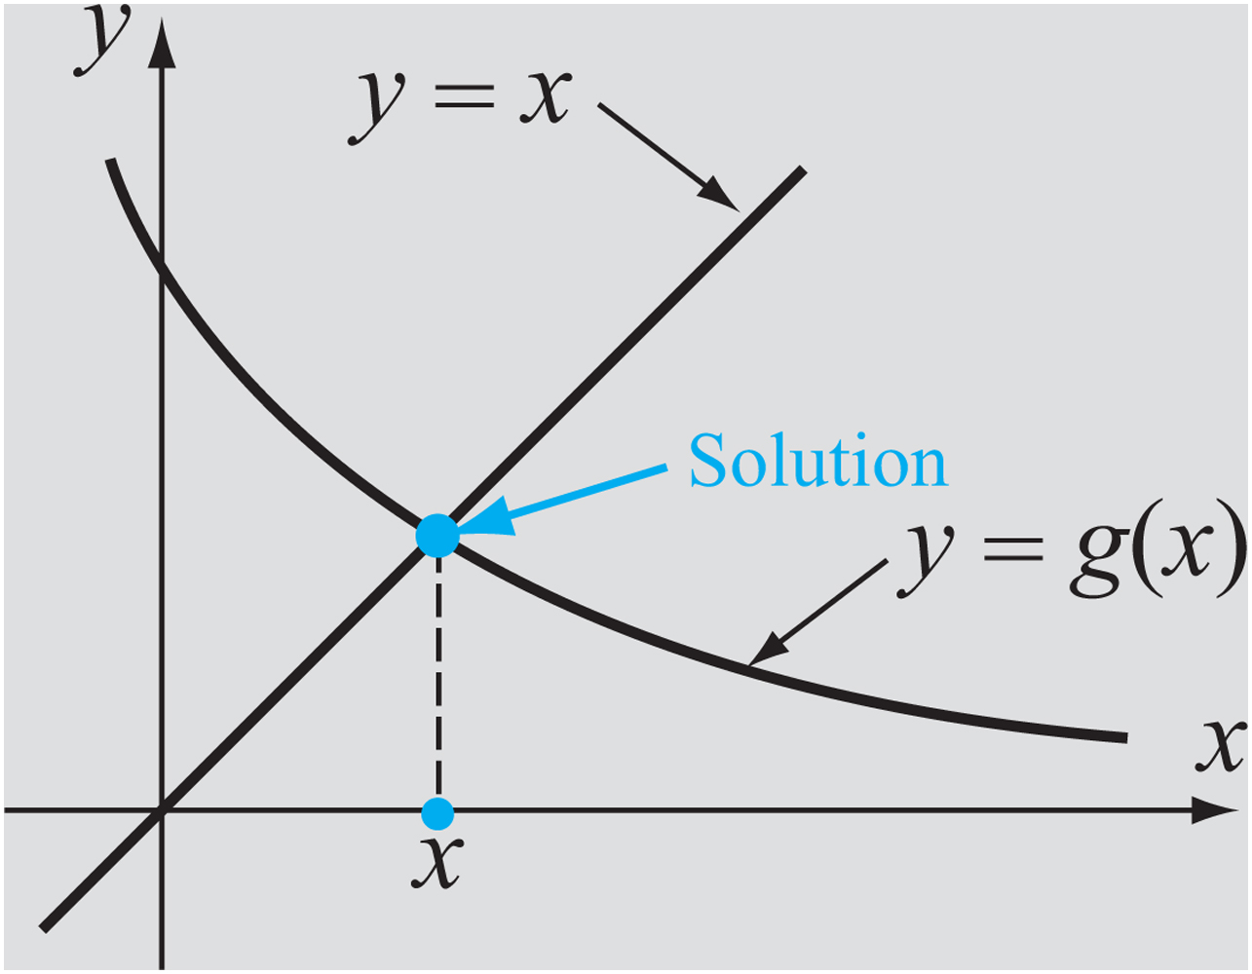
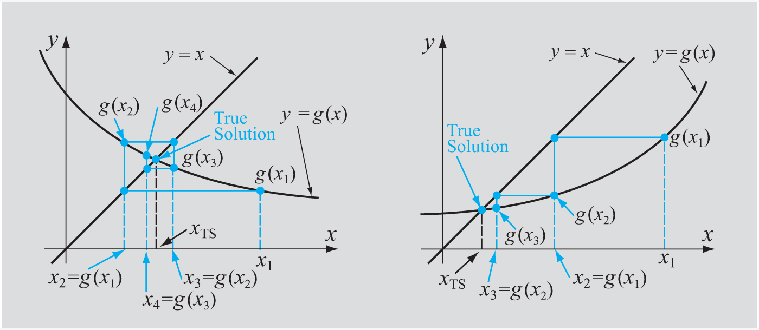
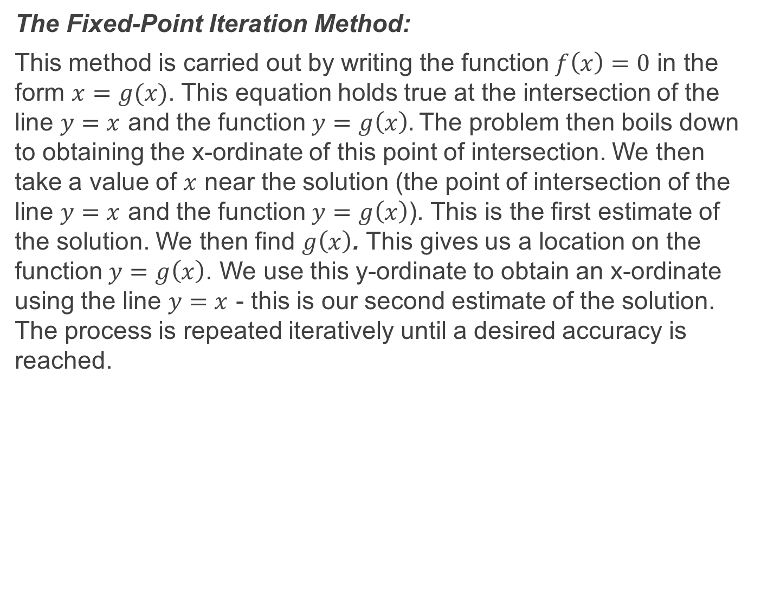
The Fixed-Point Iteration Method:
This method is carried out by writing the function $f\left(x\right)=0$ in the form $x=g(x)$. This equation holds true at the intersection of the line $y=x$ and the function $y=g\left(x\right).$The problem then boils down to obtaining the x-ordinate of this point of intersection. We then take a value of $x$ near the solution (the point of intersection of the line $y=x$ and the function $y=g\left(x\right)$). This is the first estimate of the solution. We then find $g\left(x\right)$. This gives us a location on the function $y=g\left(x\right)$. We use this y-ordinate to obtain an x-ordinate using the line $y=x$ - this is our second estimate of the solution. The process is repeated iteratively until a desired accuracy is reached.

Slide 26
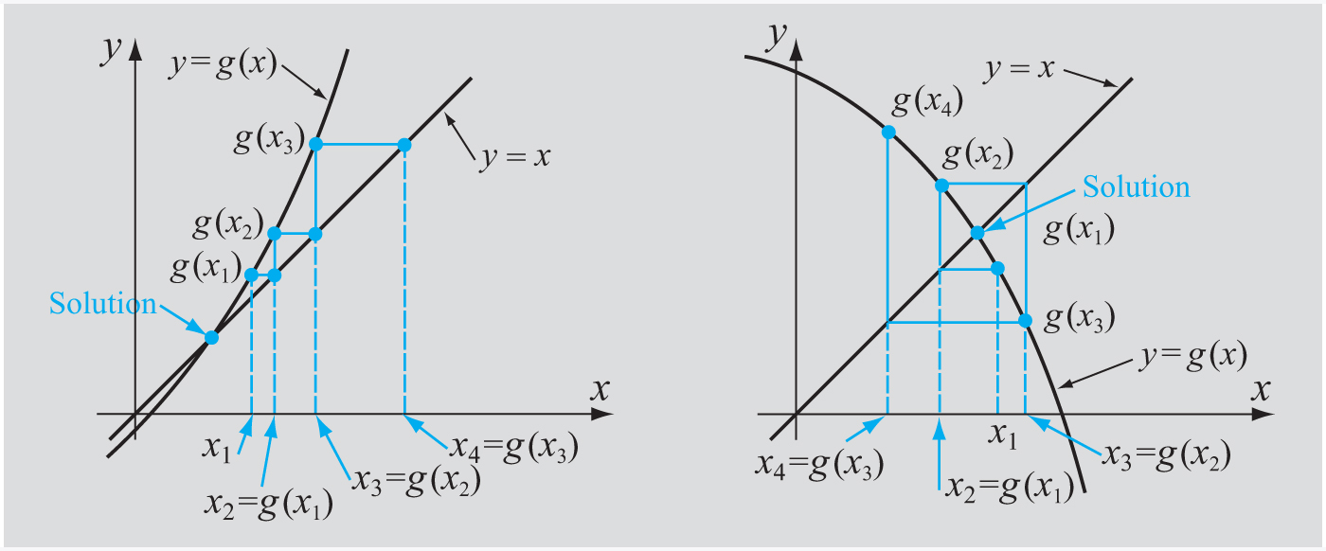
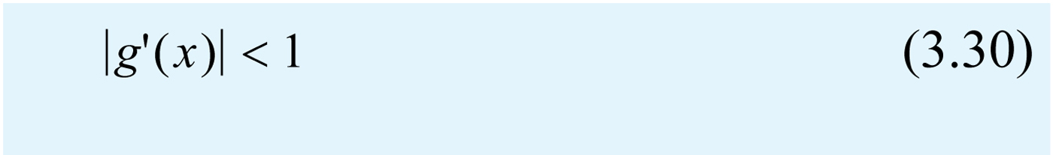
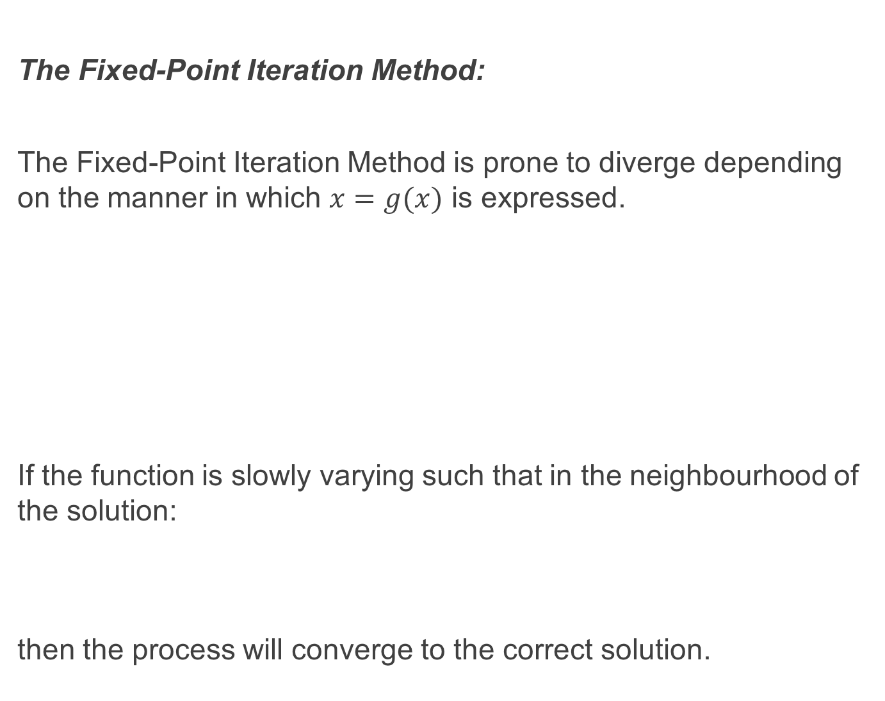
The Fixed-Point Iteration Method:
The Fixed-Point Iteration Method is prone to diverge depending on the manner in which $x=g(x)$ is expressed.
If the function is slowly varying such that in the neighbourhood of the solution:
then the process will converge to the correct solution.

Slide 27

The Fixed-Point Iteration Method:
Consider:
We can write $x=g(x)$ in a number of different ways:
$$x=\frac{5−xe^{0.5x}}{1.2}$$
or
$$x=\frac{5}{e^{0.5x}+1.2}$$
or
$$x=\frac{5−1.2x}{e^{0.5x}}$$

Slide 28

The Fixed-Point Iteration Method:
Only when expressed as the second option do we get $$\left|g′(x)\right|<1;x=1, 2$$
Hence, when expressed in this form the method converges:
$$x=\frac{5}{e^{0.5x}+1.2}$$

Slide 29


Example:

Slide 30

Systems of Nonlinear Equations:
A system of nonlinear equations consists of two or more nonlinear equations that have to be solved simultaneously. E.g. to find the intersection of a catenary and an ellipse:

Slide 31
Systems of Nonlinear Equations:
We will examine two methods for solving systems of nonlinear equations, namely:
1. Newton’s Method
2. The Fixed Point Iteration Method.

Slide 32


Newton’s Method (for Systems of Nonlinear Equations):
Consider:
Let $x_{2}, y_{2}$ be the true solution and $x_{1},y_{1}$ be the first estimate of the solution. Then the Taylor Series expansion for the functions $f_{1}$ and $f_{2}$ about${ (x}_{2},y_{2})$ is:

Slide 33



Newton’s Method (for Nonlinear Equations):
Since $x_{2}, y_{2}$ are close to $x_{1}, y_{1}$ then we can neglect the higher order terms giving:
where $∆x=x_{2}−x_{1}$ and $∆y=y_{2}−y_{1}$.

Slide 34


Cramer’s Rule and Solution to a System of Simultaneous Equations:
Cramer’s Rule states that the solution (for $\left[x\right]$), if it exists, is given by:
where $a_{j}^{′}$ is the matrix formed by replacing the $j$th column of the matrix $\left[a\right]$ with the column vector $\left[b\right].$
Note: ${\left[a\right]}^{−1}$ exists $iff det⁡(a)≠0$
$\det\left(a\right)=0$ if one or more columns or rows of $\left[a\right]$ are not linearly independent.

Slide 35



The Jacobian:
The Jacobian is a quantity that arises when solving systems of non-linear equations. Given $f_{1}\left(x,y\right)=a$ and $f_{2}\left(x,y\right)=b$ (where $a$ and $b$ are constants) then the Jacobian matrix (given here for a $2×2$ matrix) is:
The Jacobian determinant or simply the Jacobian is:

Slide 36



Newton’s Method (for Nonlinear Equations):
This system of equations can then be solved using Cramer’s Rule:
where

Slide 37


Newton’s Method (for Nonlinear Equations):
Then:
Note that $x_{2}, y_{2}$ obtained here are not exactly the true solutions since we truncated the Taylor Series. A new estimate can be obtained by repeating the process using $x_{2}, y_{2}$ as the new starting point and continuing the process until a desired accuracy is reached.

Slide 38



Newton’s Method (for Nonlinear Equations):
Newton’s Method can be generalised for a system of $n$ nonlinear equations which have the form:
which gives:

Slide 39


Newton’s Method (for Nonlinear Equations):
Algorithm:
1. Estimate an initial solution. $x_{1,i},x_{2,i},x_{3,i} …$
2. Solve Equation (3.55) for $∆x_{1}, ∆x_{2}, ∆x_{3} …$
3. Calculate a new estimate of the solution using:
4. Repeat until the desired accuracy is reached

Slide 40
Newton’s Method (for Nonlinear Equations):
Newton’s Method does not necessarily converge but when it does it does so quickly. The method will likely converge if the functions and their derivatives are continuous and bounded near the solution. Also the Jacobian must be non-zero and the initial estimates must be close to the solution.

Slide 41



Example:

Slide 42


The Fixed Point Iteration Method:
Algorithm:
1. We begin with:
2. We write:

Slide 43

The Fixed Point Iteration Method:
3. We then choose an initial estimate for the solution: $x_{1,1}$, $x_{2,1}$, $x_{3,1}, …$ which is substituted into the r.h.s. of Equation (3.58). The l.h.s. is our new second estimate of the solution.
4. We continue this process until a desired accuracy is reached.

Slide 44

The Fixed Point Iteration Method:
The Fixed Point Iteration Method will converge under the following sufficient but not necessary conditions:
1. If the functions, $g$, and their derivatives are continuous in the neighbourhood of the solution.
2. If $\sum_{i}{\left|\frac{∂g_{n}}{∂x_{i}}\right|}≤1$
3. The initial estimate is close to the solution.

Slide 45
Recommended Problems:
Problems to be solved by hand (do at least 2):
3.2, 3.8, 3.14
Problems to be programmed in MATLAB:
3.26
Problems in math, science and engineering:
3.27 (you may use only (b))
You should pick out problems that you find interesting/challenging and do these too.

